Slide 1
Agenda
Review-Hand Back Quizzes
139. Spanish-American War
Notes
Video
Primary Source Activity (Historical Thinking)
140. Westernization
Notes
Read
REVIEW: Talk about test!

Slide 2
Objectives
Explain the causes to the Spanish American War.
Explain the term Westernization.

Slide 3
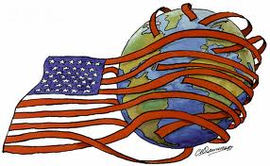
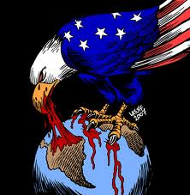
Spanish-American War
During 1800s, US followed European pattern of industrialism and imperialism.
Forced Japan to trade
Took territory from Mexico
Conquered Native Americans (moving west)

Slide 4
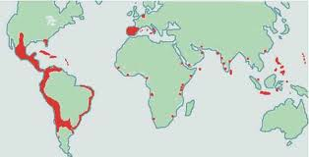
New Spain?
Only Cuba and Puerto Rico left as Spanish colonies in Americas
Notes:
Thanks to Simon Bolivar

Slide 5
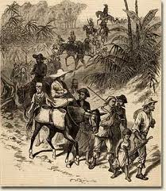
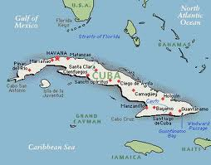
Cuban Independence
Fighting for freedom from Spain.
US sent battleship Maine to help

Slide 6
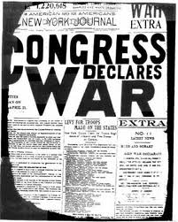
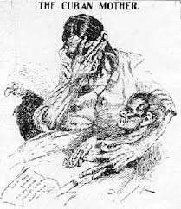
Remember the Maine The HELL with SPAIN!
Blew up- killing 266 soldiers

Slide 7
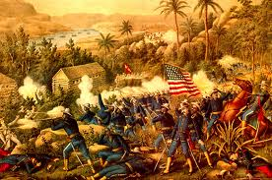
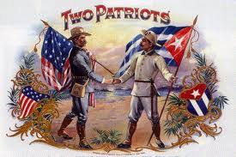
US Goes to WAR!
Lasted 4 months
US won acquired Puerto Rico, Guam, and the Philippines from Spain
US also took Hawaii

Slide 8
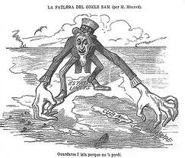
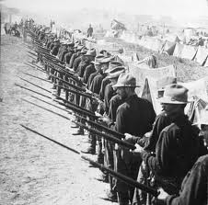
The US a power
Power in the Pacific
Vowed would take control of any Latin American country that didn’t run it’s government the way U.S. wanted it to

Slide 10
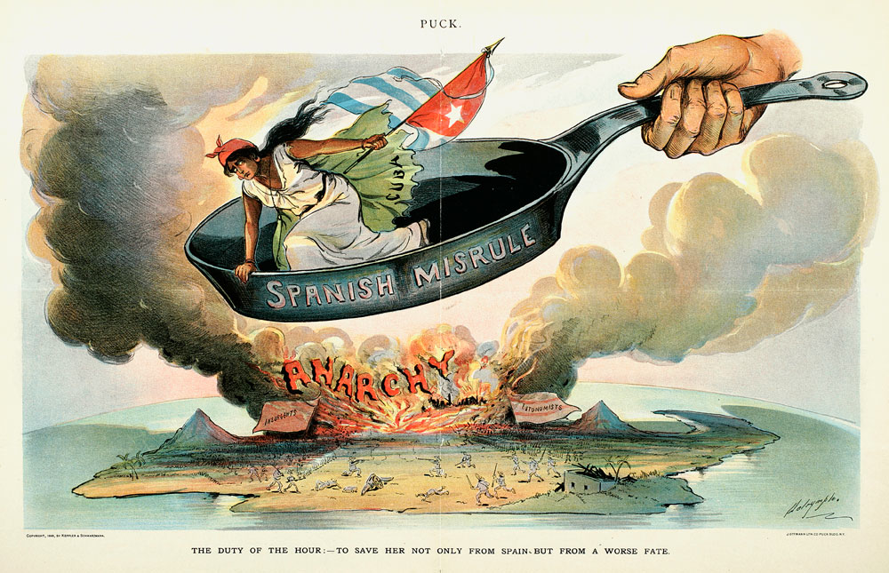
Historical Debate
What were the United States motivations to help Cuba?
What happened to the Maine?
Who blew it up?

Slide 11
Video
Spanish American War

Slide 14
American Motivation Primary Sources
Read and answer questions

Slide 15
Primary Source Maine Explosion
Doc. A
Sourcing
1. How long after the explosion of the Maine was this article written?
2. What does the headline of the article suggest about the newspaper’s point of view?
Close Reading
3. Upon what type of evidence does the New York Journal base its claims?
Doc. B
Sourcing
1. How does the date of this article compare with the date on the New York Journal and Advertiser article?
Close Reading
According to these headlines, what happened to the Maine?
3. What kinds of evidence does the New York Times include to support its account of the incident?

Slide 16
READ AND HIGHLIGHT

Slide 17
Westernization
Western world= wealthy, powerful, and aggressive

Slide 18
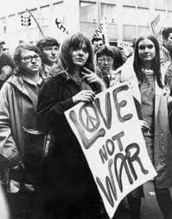
Responses to West
Fighting back didn’t work (Native Americans, Zulus)
Staying away didn’t work (Chinese, Japanese)

Slide 19
How to deal with the west…
Be more like them (Russia, Japan, Latin America)

Slide 20
How to Westernize?
Educate yourself.

Slide 21
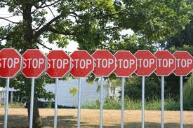
Problems?
Non-west faced obstacles
West did it first
Tough for them to get in to the international economic system

Slide 22
READ AND HIGHLIGHT

