Slide 1
Agenda
Review
Meiji Restoration
Notes
Crimean War
Notes
Videos
QUIZ NEXT CLASS
Notes:
Put a list of the topics already covered in the unit on the board as the kids walk in to class have them rate on a scale of 1-5 their understanding of each topic. This will help you know what to review.

Slide 2
RATE IT!
As you come in go around the room and rate your understanding of the topics.
1-5
1 What are you talking about
5 I’m an expert

Slide 3
Objectives
Explain what the Meiji Restoration was.
Understand how it is an example of imperialism.
Understand the significance of the Crimean War.

Slide 4
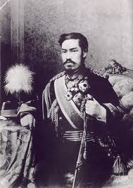
Pronunciation
Meiji: Meh (Me)---Eee(i)-----(Chi) ji

Slide 5
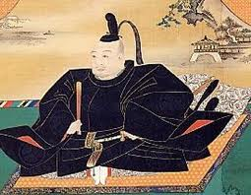
135. Meiji Restoration
Before the Meiji, what government (that we discussed in a previous unit) was in control of Japan?
Hint:
Wanted to ban firearms
Keep foreigners out!

Slide 6
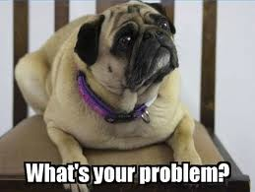
Problem
America, like the British, believed in free trade even when a country didn’t want to trade.
In 1853, Japan didn’t want to trade with America.

Slide 7
What should America do?
A. ask them nicely to reconsider their stance on trade.
B. be mean to them and criticize their country.
C. Forget about them and start trading more with China.
D. Show up at their door step with a squadron of warships threatening bombardment if they don’t start trading with America.

Slide 8
What should America do?
A. ask them nicely to reconsider their stance on trade.
B. be mean to them and talk bad about their country.
C. Forget about them and start trading more with China.
D. Show up at their door step with a squadron of warships threatening bombardment if they don’t start trading with America.

Slide 9
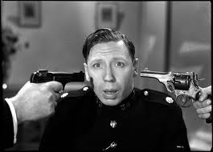
Japan’s Response
At gunpoint Tokugawa agreed

Slide 10
Unhappy citizens…
Samurai armed themselves and overthrew the Tokugawa Shogunate
Replaced with modern government = freedom for all!!

Slide 11
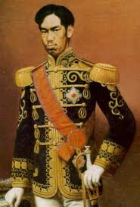
Meiji Restoration
Samurai restored power to emperor
Devotion to the god-like emperor became central to Japanese nationalism

Slide 12
Japan joins Industrial Revolution
Sent officials to West to learn
Built railways and modernized navy

Slide 13
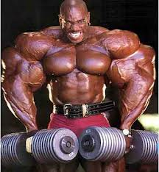
Japan now stronger than big neighbor China

Slide 14
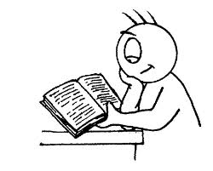
Read Meiji Restoration
Key Points
Highlight

Slide 15
Primary Source
Discussion Questions
1) How did the new leaders envision the role of citizens in the new government?
2) Which parts of this oath would you describe as "democratic," "undemocratic"? Why?

Slide 16
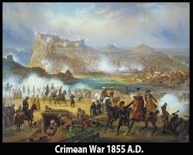
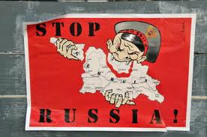
136. Crimean War
Britain and France went to war with Russia
They didn’t want Russia to keep gaining land

Slide 17
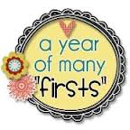
Crimean War
A war of firsts:
First modern war (railways and telegraphs)
Development of modern nursing
First war that was reported in the newspapers (daily updates)
First war to be extensively photographed

Slide 18
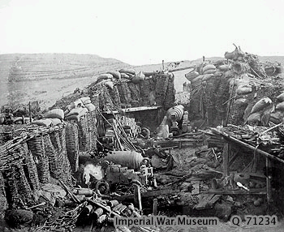
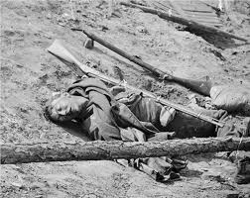
Crimean War

Slide 19
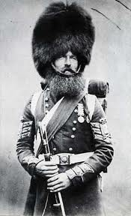
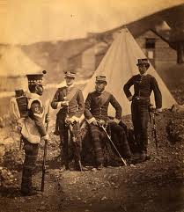
Crimean War
Fought at Russia’s door step
Crimean Peninsula

Slide 20
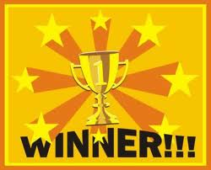
Winner?
Western Europe wins!
Better railways, weapons, and navies
Showed Russia they were way behind.

Slide 21
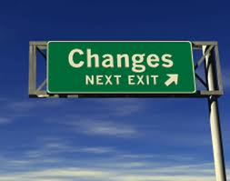
Response?
Czar freed serfs, giving them land and education.
Wanted to modernize Russia

Slide 22
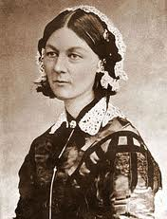
Florence Nightingale
Developed Modern
nursing
Reduced death rates in military hospitals from 45% to 5%

Slide 23
Mary Seacole
- Almost forgotten by history
Also an important nurse during the Crimean War

Slide 24
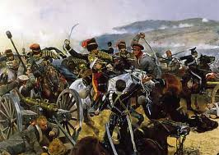
Charge of the Light Brigade
Famous poem by Lord Tennyson
Discusses a mistake of
the battle of Balaclava
Example of soldiers doing
what their told even when
it is a mistake.

Slide 25
Poem Reading
What does this poem mean?

Slide 26
Primary Source
Read The Charge of the Light Brigade
Answer question on the back page (due next class)
You may work with a partner

Slide 27
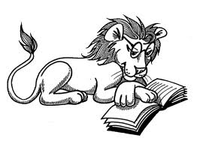
Read Crimean War
Key Points
Highlight

Slide 28
Objectives
Explain what the Meiji Restoration was.
Understand how it is an example of imperialism.
Understand the significance of the Crimean War.

