Slide 1
Agenda
Quiz
Imperialism
Notes
Read and highlight
India
Read
Videos
HW “Poem” A White Man’s Burden

Slide 2
Objectives
Understand imperialism and how Social Darwinism contributed to it.
Explain how India became a British Colony.

Slide 3
Hungry like the wolf!
Europe’s increased demand for raw materials led to an increase in Colonization / Imperialism.

Slide 4
Imperialism
1870-1914 is known as the age of Imperialism.
The control by one country of the political, economic, or cultural life of another country or region.

Slide 5
WHY?
The Industrial Revolution increased Europe’s desire for raw materials.
European factories wanted raw materials from Africa, Asia, and Latin America.
European Powers saw their colonies as markets for their finished goods.

Slide 6
Unequal
The Imperial or Colonial Power gets ALL the benefits.
The colony supplies most of the raw materials and gets little / no benefit.

Slide 7
THINK?
Is IMPERIALISM alive and well today? If so how?
Is IMPERIALISM the “natural state” of the world? Why or why not?
Do you feel that the European Powers “owe” their former colonies for the IMPERIALIST era?

Slide 8
Read/Highlight
Imperialism

Slide 9
Quick Review
Joint Stock Company
What was the most powerful one
Hint it was in India?
Mughal Empire?

Slide 10
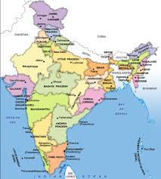
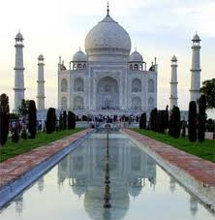
India
British steadily took India over until it was their colony.

Slide 11
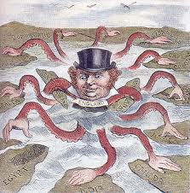
British Imperialism
Not only took India’s resources
Used many Indians as soldiers (sepoys)
Largest population of any
British colony

Slide 12
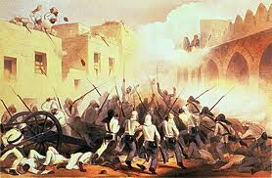
Indian uprising?
Beef fat used to seal rifle cartridges
Cows sacred to Hindus

Slide 13
British say NO NO
British quash uprising.

Slide 14
British Control
British government takes over India.
No longer under control of British East India Company.
Known as the British Raj

Slide 15
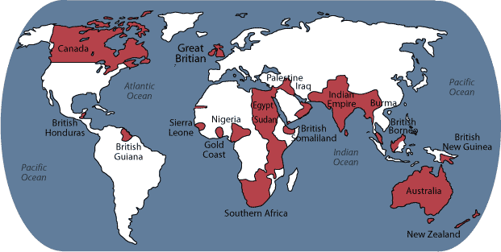
British Imperialism
India, Canada, Australia and much of Africa

Slide 16
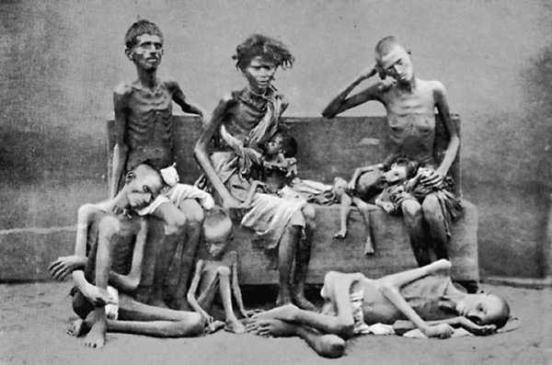
In India…
British set up postal service, telegraph, roads, railway
But hurt many

Slide 17
Primary Source Analysis/Homework
The White Man's Burden

