Slide 1
Agenda
Review
Nationalism
Notes
Read
Video
Social Darwinism
Notes
Read
Video
QUIZ NEXT CLASS!!

Slide 2
Objectives
Explain the term nationalism.
Understand how extreme nationalism led to social Darwinism.

Slide 3
129. Nationalism
Is a deep devotion to one’s country that places it above all others.
Stems from Enlightenment ideas
People wanted freedom and wanted to belong to their own nation.

Slide 4
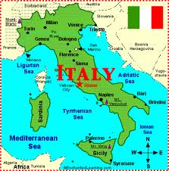
Italy
Ruled by Austrians and Spanish.
Fight for “freedom” from foreign rule.

Slide 5
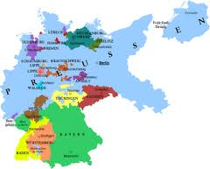
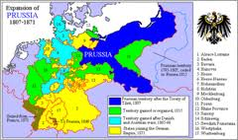
Germany
In 1850, Germany was made up for 39 small countries.
Prussian prime minister goes to war to unify Germany.

Slide 6
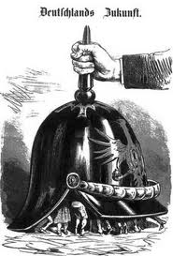
Germany Unified
By 1870, Prussian king crowned Kaiser
Emperor
Prime Minister is the head of a country’s government
American President

Slide 7
Nationalism and School Pride?
Who can make the connection?

Slide 8
Read Nationalism
Highlight

Slide 9
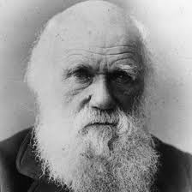
130 Social Darwinism
Can someone tell me who Charles Darwin is?

Slide 10
Story of Nationalism continued…
Early 1800s nationalism was positive
Freedom from foreign power
Latter half emerged a dark side

Slide 11
Evil Nationalism?
Glorified war
Military conquest
Supported by racism
Belief that one’s own race or culture is superior to others

Slide 12
Charles Darwin
Theory of evolution based on “natural selection”
Survival of the fittest

Slide 13
Video
http://www.youtube.com/watch?v=xOl0tHVV6Ck

Slide 14
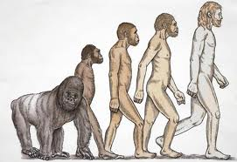
I thought this was history?
It is…
Some people took his ideas and used it to justify racist beliefs
White races were intended by nature to dominate “lesser” races

Slide 15
How does it fit with IR?
Rich industrialists believed they were superior
Intended to rule inferior workers
Natures way!

Slide 16
Video
http://www.youtube.com/watch?v=mSHZkXEQTqQ

Slide 17
School Pride to Social Darwinism?
Make connection

Slide 18
Read
Highlight

Slide 19
Assignment (Exit Slip)
Explain the term nationalism in your own words. (Use and example that makes sense to you.)
Explain how extreme nationalism led to social Darwinism. Put it in your own words.

