Slide 1
Agenda
Map Quiz
Review Industrial Revolution
Crash Course
Read, highlight
What is Socialism?
Key Points
Discuss

Slide 2
Locations
Japan
Cuba
Philippines
Canada
Australia
New Zealand
Puerto Rico
England
Spain
West Indies

Slide 3
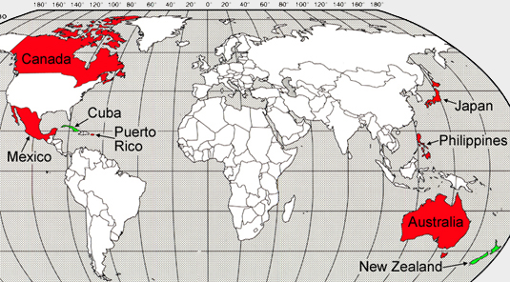

Slide 4
Objective
Understand how the industrial revolution led to socialism.
Explain the economic philosophy of socialism

Slide 5
Crash Course

Slide 6
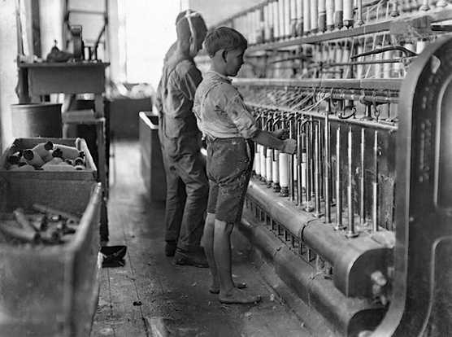
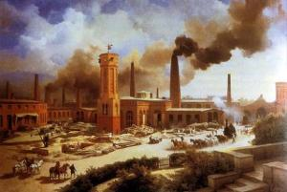
Industrial Revolution
What were the main ideas of the Industrial Revolution?

Slide 7
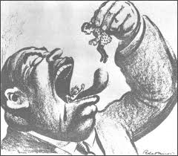
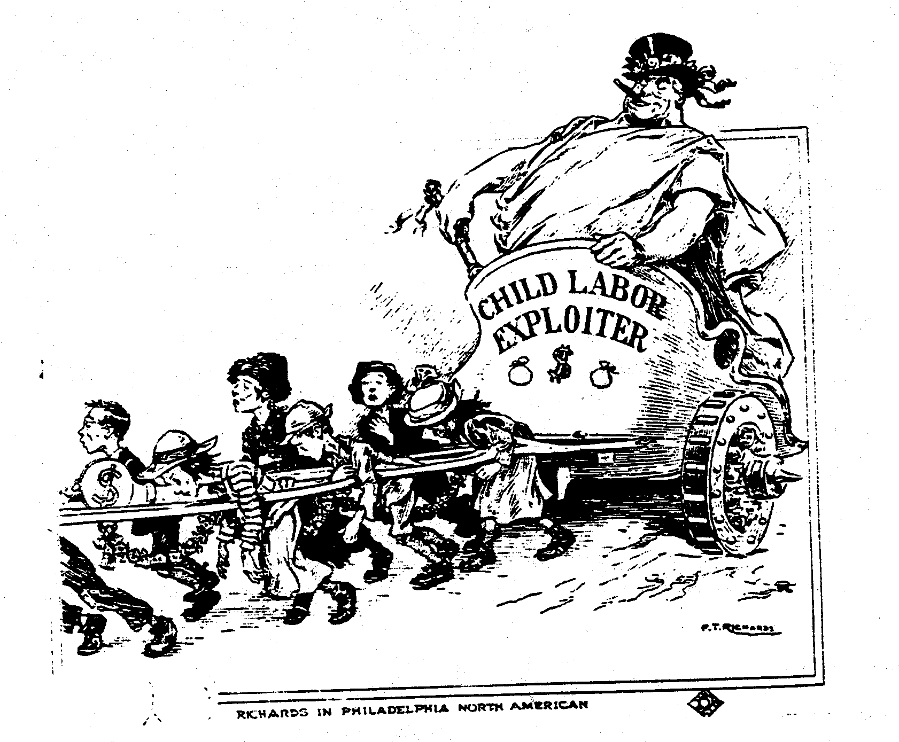
Child Labor

Slide 8
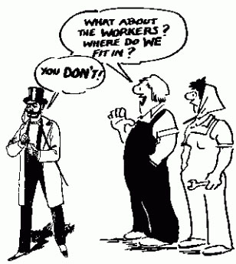
126 Socialism?
What is socialism?

Slide 9
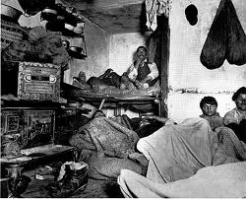
Socialism
People began migrating to cities for work
No room
Notes:
Liverpool grows from 80,000 to 375,000

Slide 10
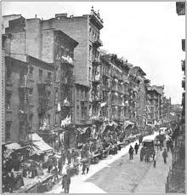
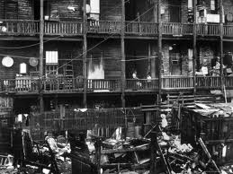
Where did they go?
People packed in to run-down apartments called tenements.

Slide 11
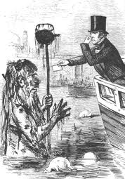
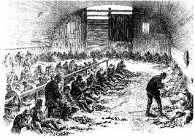
Dirty!
Lack of sewage facilities
Fifth everywhere!

Slide 12
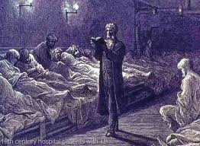
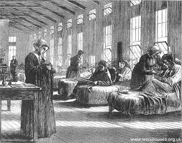
Disease
Killed one child out of every 5 by the age of four.

Slide 13
Capitalism
What is it?

Slide 14
Capitalism
Made few people wealthy (factory owners) but a majority poor (factory workers)

Slide 15
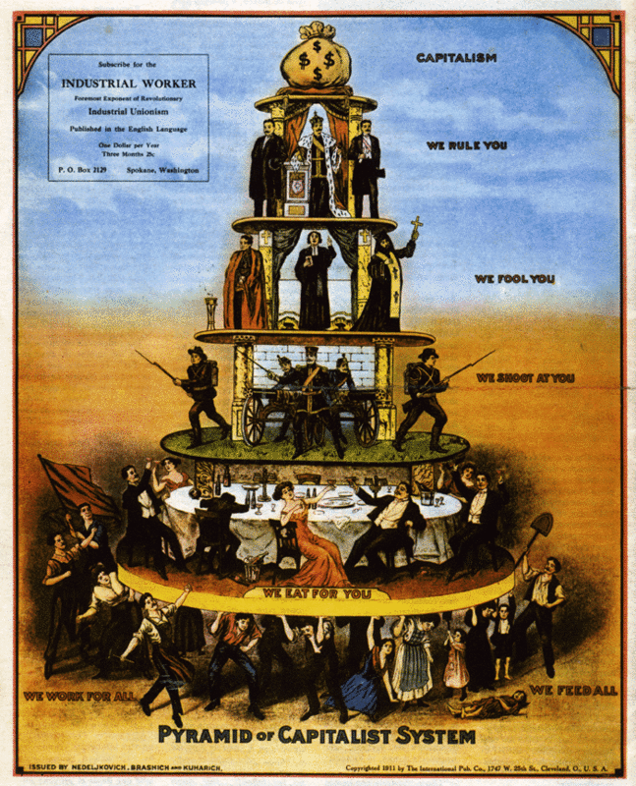

Slide 16
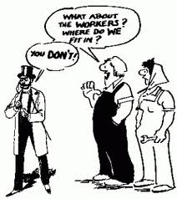
Socialism
Poor conditions lead to attraction to socialism
Socialism- economic philosophy that distributes wealth evenly

Slide 17
Socialism
Major businesses would be owned by public not a few people.
Basically the opposite of Adam Smith’s Capitalism.

Slide 18
Should we have socialism in America?
Why or why not?

Slide 19
Read and Highlight

Slide 20
Exit ticket
Text me (515-351-1758) your answer to:
How did the IR lead to socialism?
What is socialism?

