Slide 1
Agenda
Gunpowder Empires
Song Lyric Project
Quiz next class

Slide 2
Objective
Explain how gunpowder has affected the world.

Slide 3
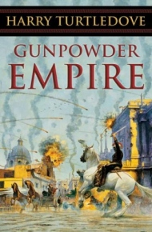
Gunpowder Empires
After the invention of gunpowder, firearms played a major role in world’s history.
Tokugawa
Mughal
Russia
European Empires

Slide 5
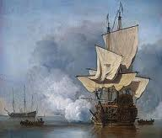
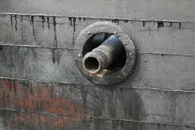
Portuguese
First to put cannons on ocean going ships

Slide 6
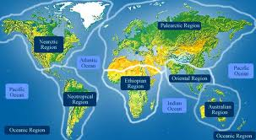
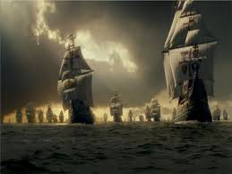
European Empires
With technologically advanced ships, Europe controlled areas in Asia and Africa
Dominated world’s oceans

Slide 7
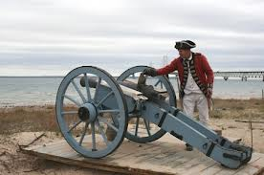
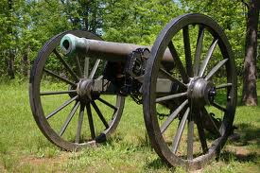
European Empires continued…
Kings in Europe had to adopt latest weapons technology to survive the endless conflicts.
In the 1800s, Europe will take over the world!

Slide 8
Read

Slide 9
Song Lyric Project
Rubric
Research Topic
Record Sources
WRITE LYRICS

