Slide 1
Agenda
Catherine the Great
Notes
radio
Mughal Empire
Notes
Lyrics?

Slide 2
Objectives
Understand Catherine’s significance on Russian history.
Explain how the British could conquer the Mughal Empire.

Slide 3
122. Catherine the Great
What been happening in Russia since Peter the Great?
Several weak emperors
Peter III married German Princess Catherine

Slide 4
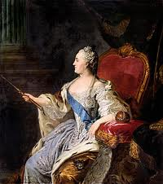
Catherine the Great
Son in line for the throne
Catherine takes over instead (empress)

Slide 5
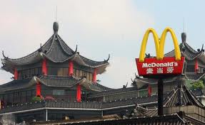
Continued westernization from Peter the Great
Farming, manufacturing

Slide 6
Enlightenment?
Friends with enlightenment philosophers

Slide 7
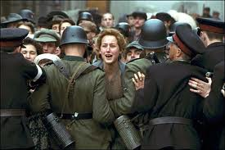
Trouble?
Peasants unhappy
War, plague, lack of food
Peasant REVOLUTION!!

Slide 8
Catherine’s Response
Abandons the enlightenment
Puts down the revolution
Rules with IRON FIST

Slide 9
Not every one liked Catherine

Slide 10
Why Great?
Expanded Russia to Poland
Took control of Crimean Peninsula
Russia grew strong and could compete

Slide 12
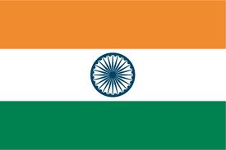
123. Mughal Empire
India before the 1700s?
Akbar practiced religious tolerance toward Hindus
Trade & Agriculture flourished
Clothed Europe

Slide 13
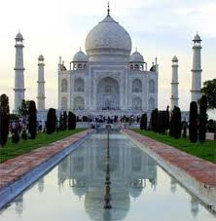
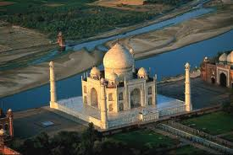
Mughal Art
Taj Mahal
Tomb built to honor wife that died during childbirth
Most beautiful building in the world

Slide 14
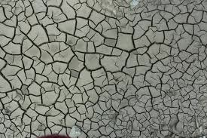
Mughal in the 1700s
Took over most of Southern Asia
War
War weakened India into fragmented states

Slide 15
Joint Stock Companies?
British East India Company defeated French and Dutch Trading Companies
Then defeated Indian armies

Slide 16
India was becoming a British Colony

Slide 18
Lyrics
Get in to groups
Decide on what topic.
Rubric next class.

