Slide 1
Agenda
Review -> Concept Map
Simon Bolivar
British Parliament
Quiz next class

Slide 2
Objectives
Determine the impact Simon Bolivar had on Latin America
Compare and Contrast the differences between the revolution in Britain with the American and French Revolutions.

Slide 3
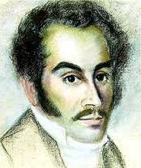
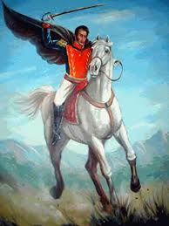
120. Simon Bolivar
American and French Revolution inspired revolutions in Latin America.
Revolutions were led by creole Simon Bolivar

Slide 4
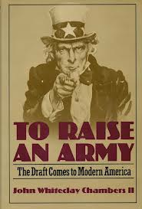
Enlightenment?
Bolivar studied in Europe
Came home and raised an army to fight for independence against Spain.

Slide 5
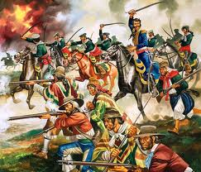
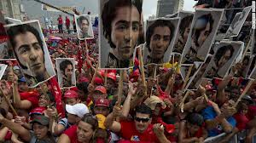
Independence?
Spain preoccupied by Napoleonic Wars
Bolivar able to win independence in Venezuela, Columbia, Ecuador, Bolivia, and Peru

Slide 6
Failure?
Unable to bring South America together as one.

Slide 7
Impact
Large
Bolivia named after him
WWF name “The Liberator”

Slide 8
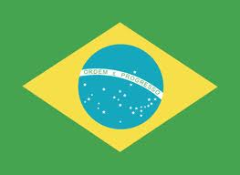
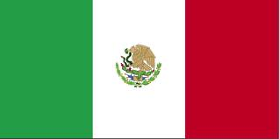
At the same time…
Central America winning freedom from Spain (Mexico and others)
Brazil wins freedom from Portugal

Slide 9
In just 20 years, the 300 year European domination comes to an END.

Slide 10
Read Highlight

Slide 12
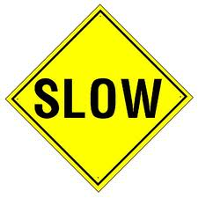
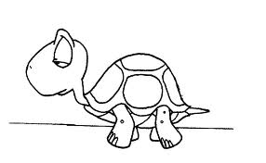
121. British Parliament
Unlike other revolutions, English took centuries
Began in 1215 with signing of Magna Carta

Slide 13
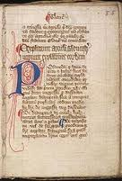
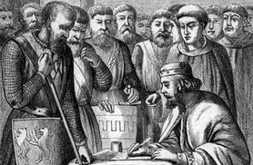
Magna Carta
Document that established the king was not above the law
Early step toward U.S. constitution

Slide 14
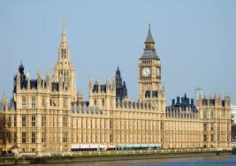
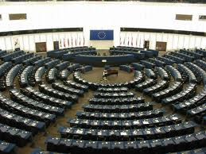
Parliament?
Great council becomes Parliament
Law making body
Removed kings that wouldn’t follow Enlightenment ideas

Slide 15
How different?
In 1700s nobility still ruled
Few people could vote

Slide 16
Britain today?
Still have royalty
True power lies with Parliament

Slide 17
Read Highlight

Slide 18
Exit Ticket
What impact did Simon Bolivar have on Latin America?
How was the British revolution different from the American and French Revolution?

