Slide 1
Agenda
Pass back quiz/essay
Explain grade -> how to do better
Correct Napoleon Assignment
Review -> Concept Map
Napoleon’s Invasion of Russia

Slide 2
Objectives
Understand the demise of Napoleon

Slide 3
119. Napoleon’s Invasion of Russia
Napoleon was at the height of power in 1812
He attempts to invade Russia

Slide 4
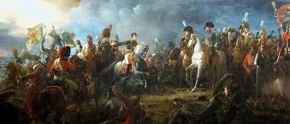
Grand Army
Over 600,000 men
Largest army ever assembled in Europe

Slide 5
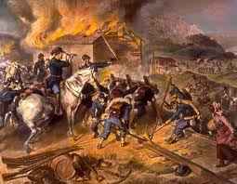
Russian Forces?
No chance of defeating Napoleon
Scorched earth policy- burn everything in his path.

Slide 6
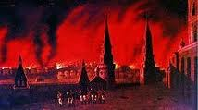
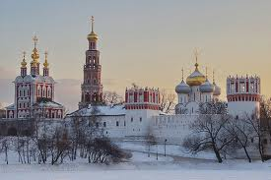
Napoleon
Gets to Moscow but it was empty and on fire
Winter coming? Time to retreat.

Slide 7
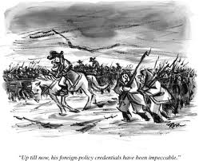
Russian Winter
Temperatures dropped to -30
Troops not prepared for winter
30,000 make it back to France

Slide 8
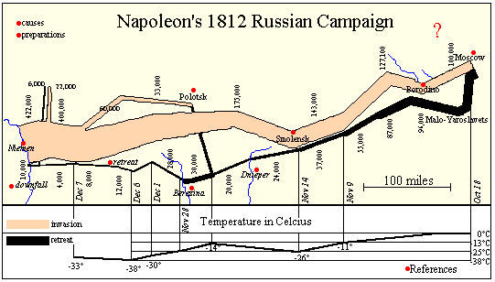

Slide 9
N. Invasion of Russia
One of the WORST disasters in military history.

Slide 10
Disgrace
Napoleon exiled to Elba
Escapes and takes over for 100 days

Slide 11
Final Defeat
Defeated at the Battle of Waterloo
Exiled again.
Dies in 1821

Slide 12
Read & Highlight

Slide 13
Exit Question
Describe the demise of Napoleon Bonaparte.

