Slide 1
Agenda
Essay
French Revolution
Reign of Terror
Discussion
HMWK

Slide 2
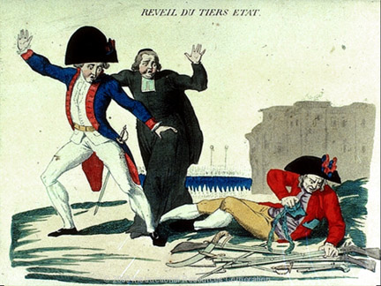
The Third Estate
A figure representing the Third Estate breaks his chains and reaches for a weapon, as an aristocrat and a clergyman flee in fear. "It's about time I woke up," he says, "because the weight of my chains was giving me a bad nightmare."

Slide 3
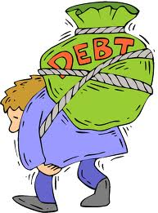
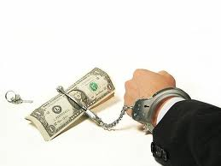
113. French Revolution
France was in debt
Estates General called to discuss raising taxes
Third Estate upset they had NO say

Slide 4
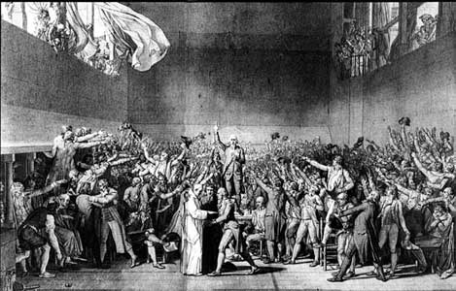
National Assembly
Tennis court oath
"not to separate, and to reassembly wherever circumstances require, until the constitution of the kingdom is established.”
Third Estate is New GOVERNMENT

Slide 5
1789 Middle class upset
Poor were hungry after bad harvest and high taxes

Slide 6
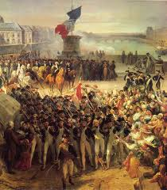
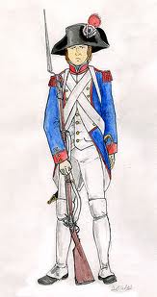
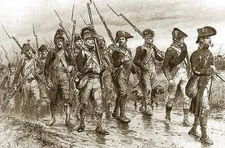
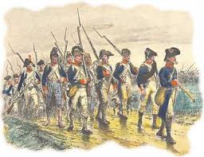
Response
King sends in the troops

Slide 7
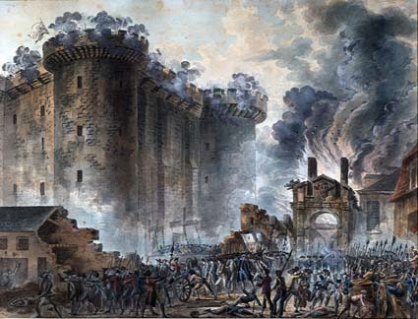
Bastille
Storming of the Bastille
July 14th 1789

Slide 8
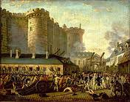
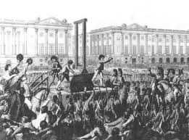
French Revolution Begins
Abolished Feudalism Lords, vassals, and fiefs

Slide 9
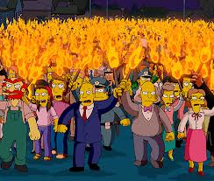
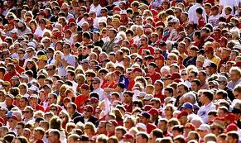
Warm up TPS
Do you act differently when you are in a group. Why or why not?
(Are you capable of doing things in a group you wouldn’t do alone? Examples…)

Slide 10
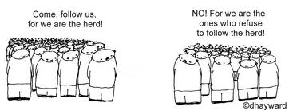
Mob mentality
describes how people are influenced by their peers to adopt certain behaviors, follow trends, and/or purchase items

Slide 11
Example Video
Video

Slide 12
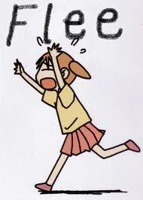
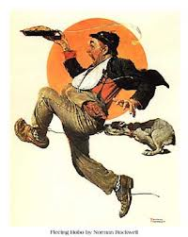
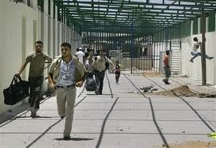
114. Reign of Terror
Nobles were fleeing to other countries
Tried to get foreign kinds to stop the revolution

Slide 13
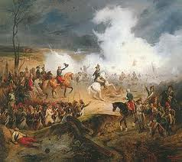
France Goes to war
Prussia, Austria, Britain, Spain, and the Netherlands
France drafts army (1,000,000)

Slide 14
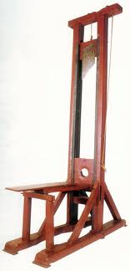
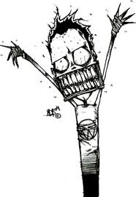
Craziness!
With the wars happening RADICALS took over the revolution.
Very harsh punishments
King and Queen sent to the Guillotine

Slide 15
Reign of Terror
Guillotine
25,000 people died by the guillotine in France’s “Reign of Terror”
50,000 total

Slide 16
Guillotine
Video

