Slide 1
Agenda
Map Quiz
Collect HMWK
Review: Read topics discussed last class
American Revolution
America the Story of us
The Third Estate
Notes
HMWK DBQ: Causes of French Revolution
Notes:
I didn’t do the map quiz just put it up their so they study! I did it next class!

Slide 2
Objectives
Understand the importance of the American Revolution on the world’s history.
Understand what the third estate was and why they weren’t happy.

Slide 4
Locations
India
Egypt
Crimean Peninsula
Moscow
Austria
Brazil
Mexico
Belgium
Great Britain
Haiti

Slide 5
Review
Read topics
Discuss Homework.
Listen to Adam Smith song.

Slide 6
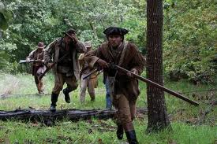
American Revolution
America the Story of Us
Complete viewing guide (in notebook)

Slide 7
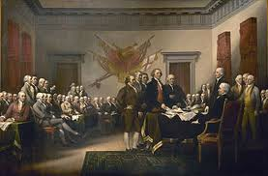
Read American Revolution
Underline.

Slide 8
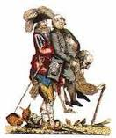
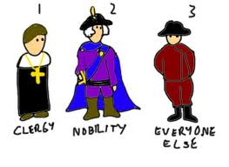
Third Estate
Enlightenment started in France but hadn’t changed much.
Under the Ancien Recime there were 3 classes in France

Slide 10
Social Hierarchy
Prior to French Revolution
3 classes called estates:
First Estate: clergy
Second Estate: nobility
Third Estate: Everyone else/commoners

Slide 12
What’s the problem…
Clergy and nobles (1st/2nd Estate) made up 2% of the population
Owned 33% of all land in France
Paid little to no taxes

Slide 13
Third Estate
Made up 98% of the population
Included the middle class
Paid nearly ALL the taxes

Slide 15
Biggest Problem
Third Estate had not say in government
Many couldn’t afford food.

Slide 16
HMWK- DBQ
Causes to the French Revolution
Intro to essay writing (get used to it!)

