Slide 1
Agenda
Map
Warm up
Enlightenment
Notes
Video
Song
Adam Smith
Primary Source
Song
DBQ HMWK!

Slide 2
Map Locations

Slide 3
TPS
What makes a good society?

Slide 4
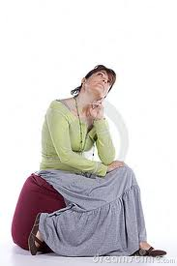
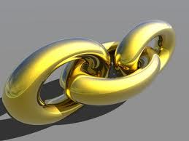
Linking last unit to this unit…
Discoveries from the Scientific Revolution led European thinkers to question human life.
They had a more modern way of thinking.

Slide 5
The Age of Enlightenment
1700-1789

Slide 6
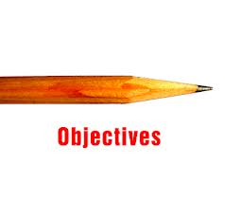
Objective
To understand the ideas behind the Age of Enlightenment
To understand how those ideas affected politics, society, and economics

Slide 7
The Age of Enlightenment
A period of intellectual exchange in Europe during the 18th century
“Progress”
A desire for political and social change

Slide 8
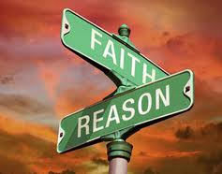
The Philosophes
Intellectuals who discussed ideas
Used reason to explain their world
Believed that Reason could improve society
Believed in tolerance for all religions

Slide 9
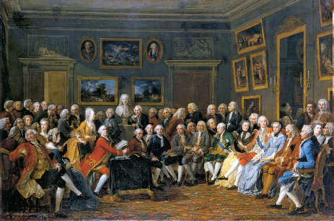
The Philosophers

Slide 10
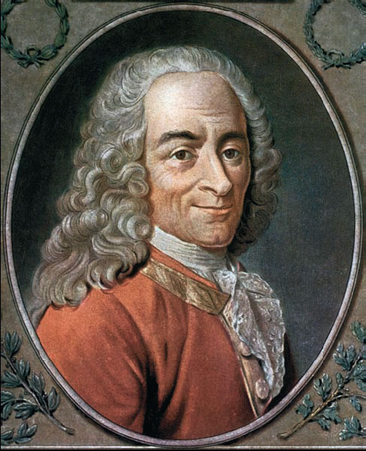
Voltaire (1694-1778)
French intellectual who criticized French society

Slide 11
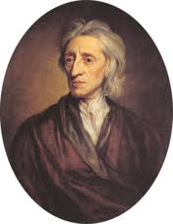
John Locke (1632-1704)
Treatises on Government
Essay on Human Understanding
“Tabula Rasa”

Slide 12
The Encyclopedia

Slide 13
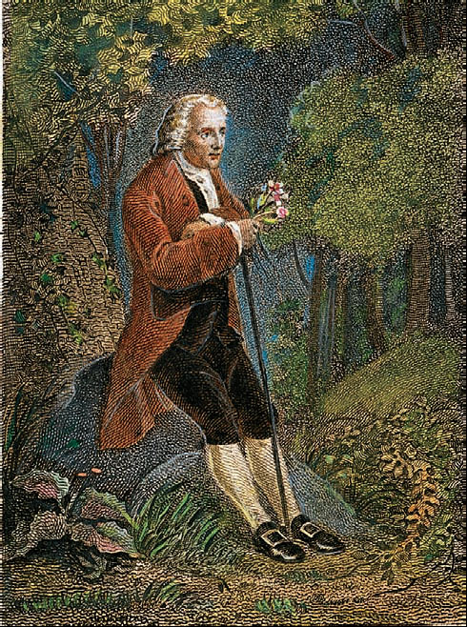
Jean-Jacques Rousseau (1712-1778)
The Social Contract (1762)
The “General Will”

Slide 14
Social Contract Theory

Slide 15
The Enlightenment Song student-written & performed

Slide 16
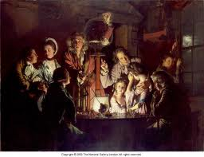
Read the Enlightenment

Slide 17
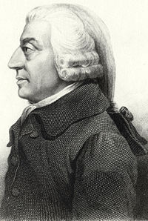
Adam Smith (1723-1790)
First modern economist
The Wealth of Nations (1776)
Laissez-Faire

Slide 18
The Wealth of Nations

Slide 19
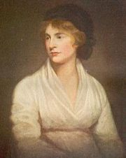
Mary Wollstonecraft (1759-1797)
Wrote A Vindication of the Rights of Women
Founder of modern feminism

Slide 20
Conclusion
The Enlightenment was a period of intellectual exchange in Europe during the 18th century
Several factors contributed to the Enlightenment
Philosophers expressed desire for social and political change

Slide 21
Primary Source Debate
Can I have two volunteers: one to play Mary and another to play Jean

Slide 22
Discussion
Main idea/thesis of Jean Jaques Rousseau:
Main idea/thesis of Mary Wollstonecraft:

Slide 23
Discussion
Do any of these arguments about essential difference in male/female attributes influence ideas about women’s intellectual abilities today?
Are there areas today where you think inequality in the education of girls and boys still exists? Where?

Slide 24
Discussion
Are there events, places, or classes which you feel either gender mostly is excluded from? What are they?
Is this okay, or do you have ideas on how this could be changed?

Slide 25
DBQ Introduction: Adam Smith

