Slide 1
Agenda
Quiz
Review (Timeline)
Anticipatory Set
Counter Reformation
Notes
Video
Invitation

Slide 2
Objective
Demonstrate an understanding of the Catholic Churches response to the Protestant Reformation.

Slide 3
Anticipatory Set
After you see the scenario write what will happen next.

Slide 4
The telephone rings…

Slide 5
You didn’t study for your World History test…

Slide 6
Your alarm doesn’t go off…

Slide 7
For every action, there is a…

Slide 8
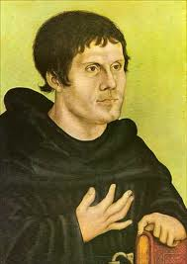
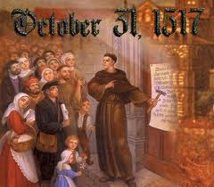
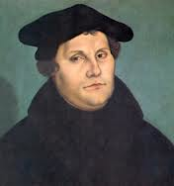
Martin Luther
Martin Luther’s actions against the Catholic Church illicit a reaction.

Slide 9
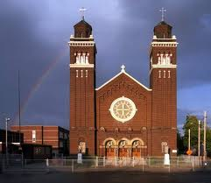
Catholic Church losses…
Loss of land
Loss of churches
Loss of contributions and riches
Loss of political influence
= NOT HAPPY CATHOLIC CHURCH

Slide 10
Background Video
Secret Files of the Inquisition Part 1
Write down 2 things you are familiar with
One new thing about the Catholic Response

Slide 11
Inquisition
Fight against heretics
What actions from the pictures did the Catholic Church take?
Make List

Slide 17
Catholic Reforms
The Catholic Church did make positive changes (along with the negative ones)
Task: Design an invitation to invite former Catholics back to the Church. Invitations should include what has been done to change what needed changing.
Due at the end of class.

Slide 18
What to look in to?
The Inquisition
The reforming orders
The Index
The Council of Trent
Big Idea: Counter Reformation or Catholic Reformation

Slide 21
Read 104 Counter Reformation
Highlight

