Slide 1
Agenda
Turn in HW
Content Quiz 1
Video African Slave Trade
Concept Map Review
New Spain
Qing Dynasty

Slide 2
Video review of Slave Trade
Read
Key Point Sentence
Highlight

Slide 3
New Spain

Slide 4
Spanish conquistadors arrive

Slide 5
Social Hierarchy
Pure-bred
Spaniards
Spanish born
in America
Mestizos
Mulattos
SLAVES

Slide 6
Think-Pair-Share
If the Chinese had “discovered” and settled in the United States rather than Europeans, how would your life today be different? (religiously, culturally)

Slide 7
Qing Dynasty

Slide 8
Voyages of Zheng He
Led all 7 voyages
EVERYTHING WAS HUGE (distances & ships)
S.E. Asia to East Afric
“Floating City” sailing throughout Indian Ocean
16 countries sent tribute to Ming
Too much $$$$$!!!!!
1433: Voyages ended

Slide 9
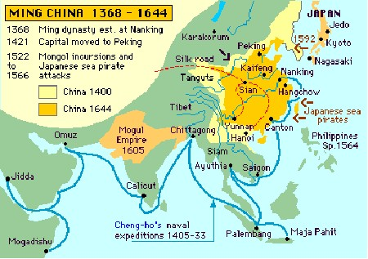
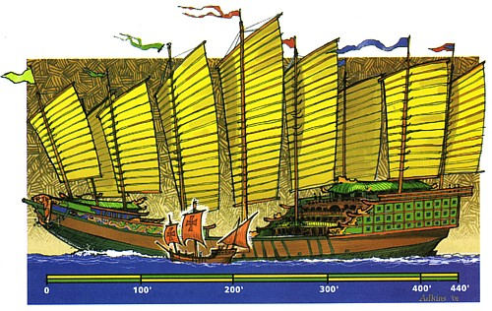

Slide 10
China Under Ming (1368-1644)
China = dominated Asia
Vassal states = paid tribute
Ming moved capital to Beijing in 1398
Created the Forbidden City (1406-1420)
Funded 7 exploratory voyages
Impress the world & gain more tribute

Slide 11
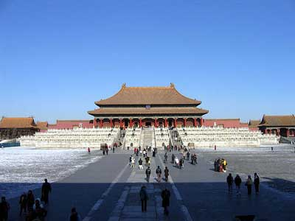

Slide 12
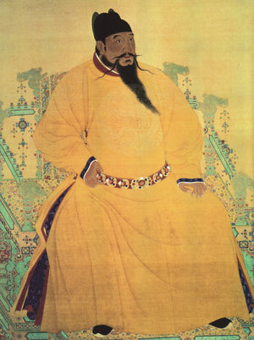
The Qing Dynasty
1600: Ming rule declines
1644: Manchus establish the Qing Dynasty

Slide 13
Manchus Continue Isolation of China
Foreigners has to obey Chinese rules of trade
Select ports, tribute, kowtow
Dutch accepted the rules
China remained isolated until mid-1800s

Slide 14
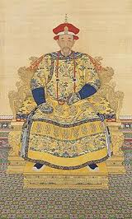
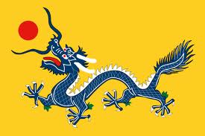
Qing Dynasty
Key Points
Why Important?

