Slide 1
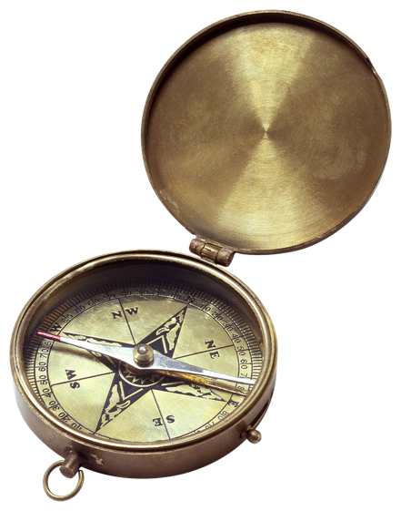
Agenda
Map Quiz
Eyewitness to History pg. 82
The Columbian Exchange
Homework

Slide 2
Objectives
Explain the importance of the Columbian exchange had on the history of the world.
Understand the impact the Columbian Exchange had on the native Americans

Slide 3
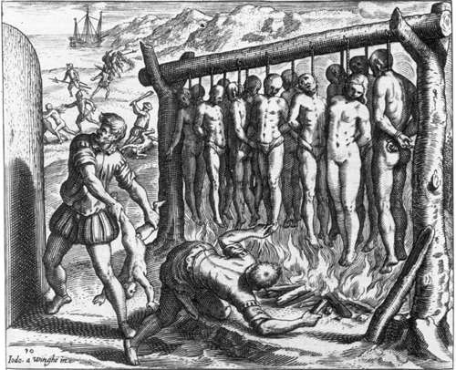
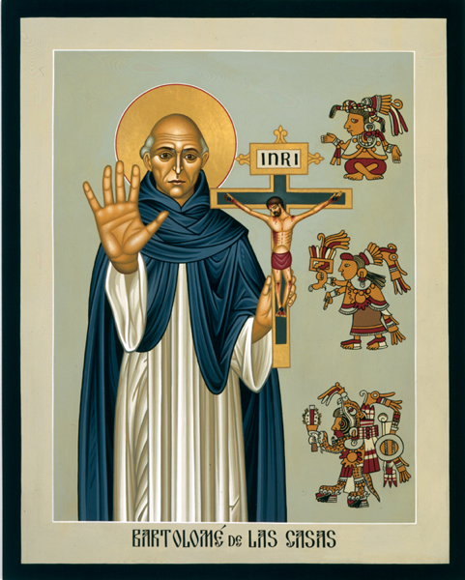
Eyewitness to History
Pg. 82 Spanish atrocities against people of the Americas

Slide 4
What are your reactions to this excerpt?
How does this strengthen or weaken the article we read about Christopher Columbus?

Slide 5
The Columbian Exchange
Definition: the transmission of non-native plants, animals, and diseases from Europe to the Americas, and vice versa.
the Columbian Exchange may be the most important event in the modern history.

Slide 6
What it explains?
Why Indian nations collapsed
Why European nations became wealthy & powerful
Why Africans were sold into slavery

Slide 9
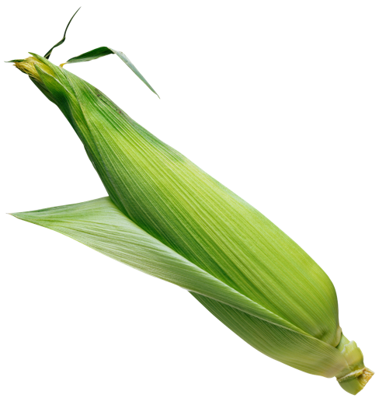
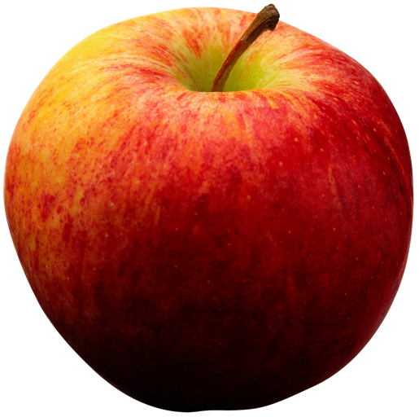
Read the Columbian Exchange
Highlight

Slide 10
Review
What was the Columbian Exchange?
How did it impact history?
What impact did the Columbian Exchange have on the native Americans?

Slide 11
Homework
Due Friday
Written or typed (I prefer typed)
Make sure to put the correct heading on your assignment

