Slide 1
Agenda
Trip?
Review (Quiz Thur/Fri, map?)
Anticipatory Set
Video
TPS
The Wars of Religion
Notes
Divine Right Monarchs
Notes

Slide 2
Objectives
Understand what the Wars of Religion were and how they impacted European history.
Explain what divine right monarchs were and how they came to rule European countries.

Slide 3
Anticipatory Set
Burning at the Stake

Slide 4
TPS
Would you die for your religion?
OR
Why would someone die for their religion?

Slide 5
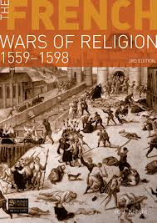
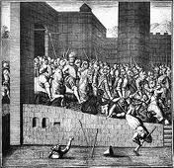
The Wars of Religion
Protestant & Catholics fought for more than 100 years.
Both believed God was on their side.

Slide 7
A Jesuit Disemboweled

Slide 8
St. Bartholomew's Day Massacre

Slide 9
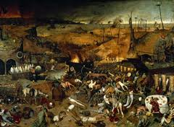
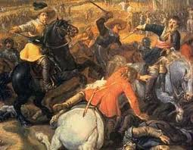
Thirty years war…
Involved most of Europe
1/3 of Germany dead
Europe DEVASTATED
Man made disaster

Slide 10
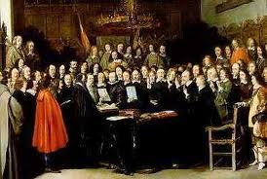
Treaty of Westphalia (1648)
Officially ended the 30 years war
Decreed that rulers could choose their own religion.

Slide 11
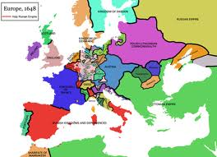
Lasting impact?
Southern Europe (France, Italy, Spain) stay Catholic
Northern Europe (Germany, England, Scandinavia) Protestant
Same religions today

Slide 12
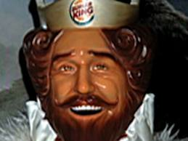
DE-throned
Spain is replaced by France as the most powerful country in Europe (England close)

Slide 13
Read and Highlight
The Wars of Religion

Slide 14
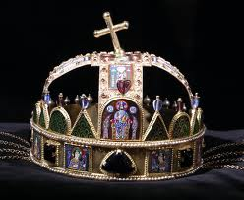
Divine Right Monarchs
European kings were extremely powerful
Nations were wealthy from trade
People looked to monarch to stop the fighting

Slide 15
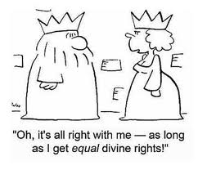
Divine Right Monarchs
Were monarchs that claimed their right to rule came directly from God.

Slide 16
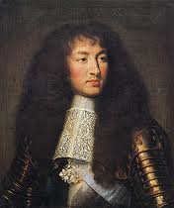
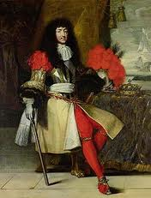
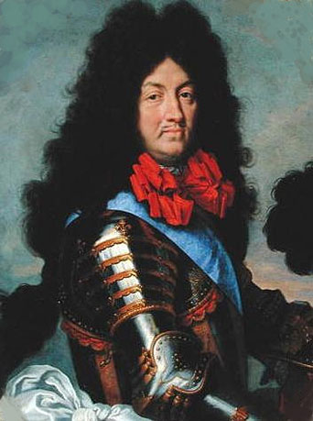
Louis XIV
Grandest of divine right monarchs
Called himself “Sun King”
Ruled for 72 years

Slide 17
Versailles
Had a palace built for a “god-king”
MASSIVE

Slide 21
Read and Highlight
Divine-right Monarchs

Slide 22
Independent Practice
Google “St. Bartholomew Day Massacre”
Create a primary source
Could be a diary, newspaper article, or anything.

Slide 23
It should say what happened.
It should be tied to the Wars of Religion
MUST be a first hand account.
Write it as if you were there.

