Slide 1
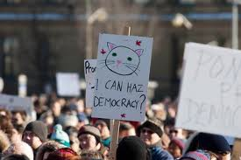
Agenda
Turn in Essay
Democracy
Notes
Videos
Global Warming
Notes
Videos
NO MORE LEARNING JUST SHOWING ME WHAT YOU KNOW!!!

Slide 2
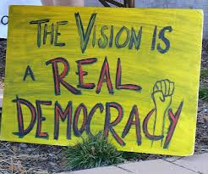
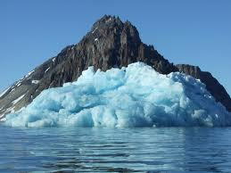
Objectives
Explain the threats to democracy and how we can keep a strong democracy in America.
Understand global warming and what threatens our environment today.

Slide 3
187. Democracy
Most countries claim to be democratic, it is not easy to achieve or maintain.

Slide 4
Struggling?
In Eastern Europe (former USSR)

Slide 5
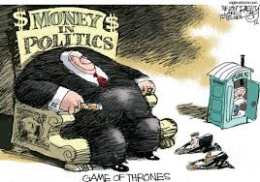
American Democracy Threat?
The huge amounts of money needed to win elections.

Slide 6
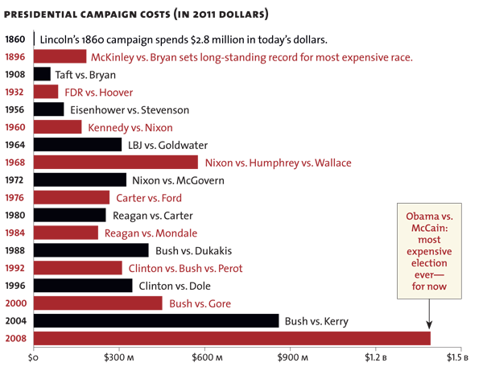

Slide 7
When someone does you a favor you do what?
Thank them and do nothing
Thank them and repay the favor
Take it and forget about it
Talk bad about them on facebook

Slide 8
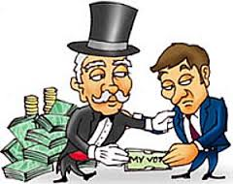
When someone does you a favor you do what?
Thank them and do nothing
Thank them and repay the favor
Take it and forget about it
Talk bad about them on facebook

Slide 9
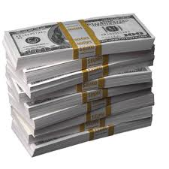
American Democracy?
Politicians do the same thing.
They repay campaign contributions through favors.
Sometimes trumps interests of citizens.

Slide 10
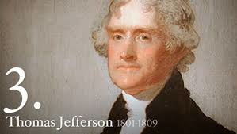
Thomas Jefferson
“The people are the ultimate guardians of their own liberty”
Believed the study of history helps give citizens the knowledge to protect their democracy.

Slide 11
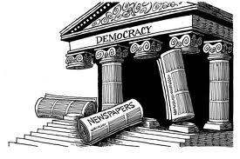
When does democracy work?
Only when there is a free press and citizens with an understanding of the world.

Slide 12
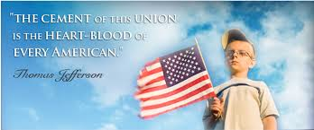
Citizens impact
Civil Rights movement
Stopped the Vietnam war/ Iraq and Afghanistan

Slide 13
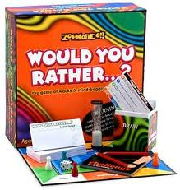
Would you rather…
Have clean air or clean drinking water?
Cure aids or cure cancer?
Feed the hungry in Africa or feed the homeless in America?
Eliminate trash and plastic in the ocean, or reduce unemployment by 5%
Fix the economy or solve global warming?

Slide 14
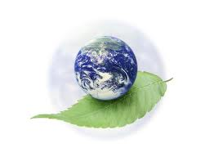
188. The environment (Last)
Our final topic may be the BIGGEST.

Slide 15
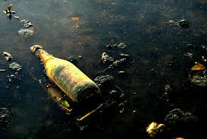
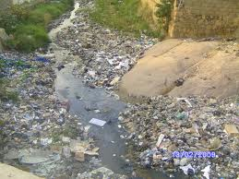
If humans destroy the earth’s environment, nothing else matters.

Slide 16
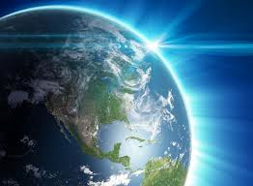
Complexity
System of interaction between the atmosphere, weather, chemical compounds, and human activity.

Slide 17
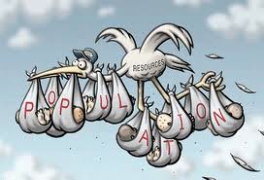
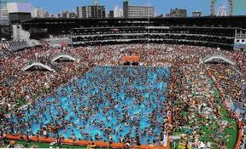
Humans?
Are altering this balance through overpopulation and pollution.

Slide 18
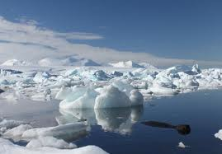
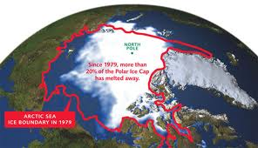
Scientists?
Agree that humans are causing global warming.
Melting polar ice, raising ocean levels, and

Slide 19
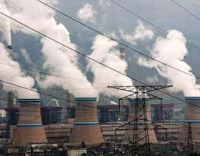
United States
World’s largest polluter
Only industrial nation not to approve Kyoto Agreement to limit the production of greenhouse gases.

Slide 20
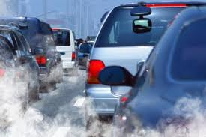
Pollution
Carbon dioxide from cars and power plants collect in the atmosphere and trap the sun’s heat

