Slide 1
Agenda
Quiz
Arab Spring
Notes
Video
Capitalism
Notes
Video
Essay
Quiz Next Class

Slide 2
Objectives
Explain what the Arab Spring is.
Understand how capitalism has evolved since Adam Smith

Slide 3
Analyzing Political Cartoon
1)What do you know about the Arab Spring?
2) Describe the symbolism you find in the image.
3) Describe what is going on in this picture.
4) What message is the artist trying to convey?

Slide 4
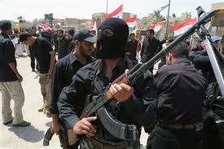
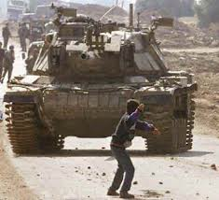
179. Arab freedom uprisings
The middle east has had a century of war and conflict.

Slide 5
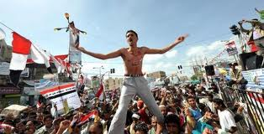
Spring 2011
Young people in the Arab world wanted something better.

Slide 6
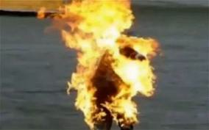
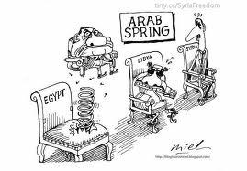
REVOLUTION!
Starts in Tunisia when a street vendor set himself on fire to protest corruption.
Thousands begin to protest their government.

Slide 7
It worked
Leaders in Tunisia and Egypt forced out.

Slide 8
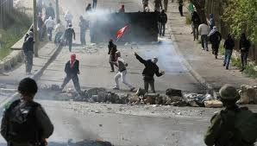
Spread to other countries…
Some rulers promised freedoms, others killed protesters
Example of how globalization affects conflict
Spread through social media

Slide 10
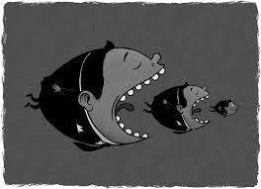
185. Capitalism
Survived the Great Depression.
Most countries have capitalist economic systems.

Slide 11
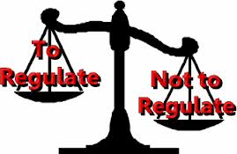
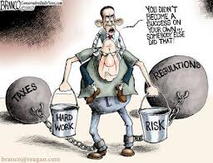
Adam Smith vs Today
Governments tightened regulations of business and banks

Slide 12
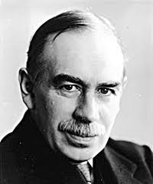
John Maynard Keynes
Unlike Adam Smith, Keynes said governments SHOULD interfere in the economy.

Slide 13
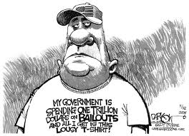
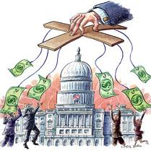
Keynes ideas…
Governments can stabilize economy by raising or lowering taxes and government spending
Spending meant more jobs and increase demand for goods
Provide safety net for citizens (Social Security and Medicare)

Slide 14
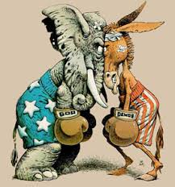
Conservative vs Liberal?
Conservatives believe Smith is right
Liberals believe Keynes is right
(more or less)

Slide 15
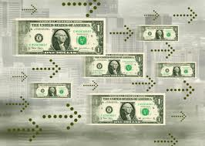
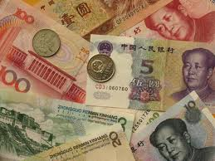
Money flow
Money goes to countries where wages are less
Meaning money is going to China

Slide 16
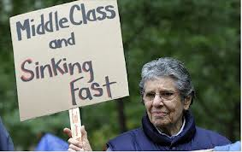
The shrinking middle class
This levels incomes across nations.
Workers in China now make more, US workers earn less
US middle class shrinking…

Slide 17
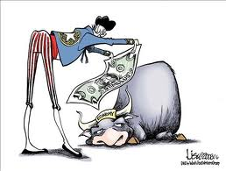
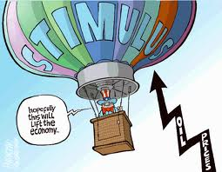
Recession of 2008
US tried Keynes ideas of government spending

