Slide 1
Agenda
Review
Terrorism
Notes
Video
Iraq
Notes
Video
Debate

Slide 2
Objectives
Understand why and how terrorism has impacted America.
Explain why the US invaded Iraq and how the invasion was perceived by the rest of the world.

Slide 3
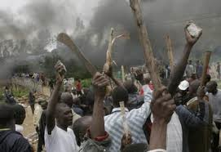
1) Why do people resort to violence to make a point?
2) Is violence effective in making your point?

Slide 4
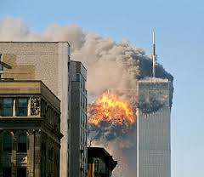
Terrorism defined
Refers to attacks against civilians not conducted by a government.

Slide 5
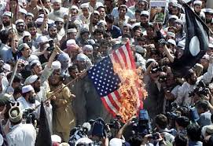
183. Terrorism
The Islamic revolution in Iran marked a new force… Islamic fundamentalism.

Slide 6
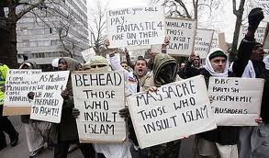
Fundamentalist
Believe religion should influence politics.
Usually intolerant of other religions.
Christian fundamentalism grew in US at same time.

Slide 7
Muslim extremists
Used Islamic fundamentalism to justify violent acts. (i.e. 9/11)

Slide 8
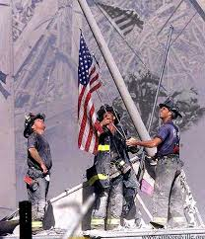
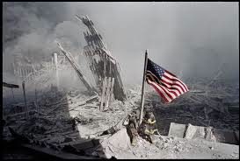
September 11th, 2001
Killed 3,000 people at World Trade Center and the Pentagon.

Slide 9
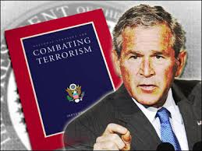
George W. Bush
After attacks, President declares a “war on terrorism”

Slide 10
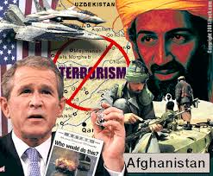
Al Qaeda
Was behind 9/11 attacks, located in Afghanistan
U.S. invaded Afghanistan and later killed al Qaeda leader, Osama bin Laden
US has started to withdraw troops.

Slide 11
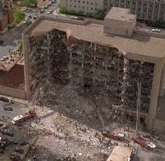
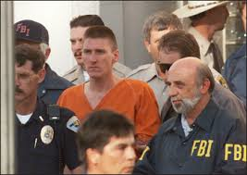
Domestic Terrorism
Terrorism may take other forms.
1995, homegrown anti-government terrorists killed 168 people with a truck bomb in Oklahoma City.

Slide 12
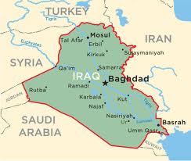
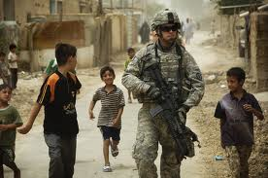
184. Iraq
In 2003, US invaded Iraq and overthrew Saddam Hussein.

Slide 13
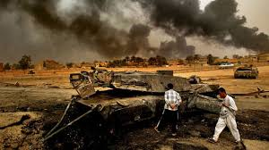
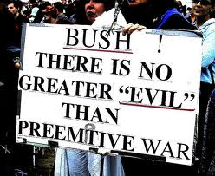
Preemptive War
US may attack a country that has done nothing to threaten or harm America if US leaders feel the country might want to harm America in the future.

Slide 14
Why did US use preemptive war?
Possible reasons:
President Bush thought Iraq had WMDs
President thought Hussein was insane
President thought his dad didn’t take care of Hussein in the Persian Gulf War
President thought Hussein was involved in 9/11 terrorist attacks
U.S. wanted to control Middle East oil supplies

Slide 15
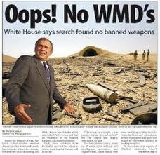
President said Iraq had WMD and indicated Hussein was involved with 9/11
Both turned out to be false.

Slide 16
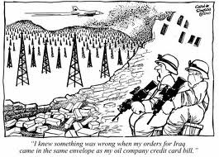
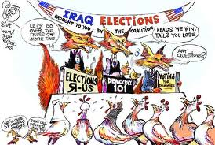
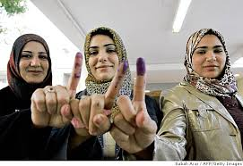
Right or Wrong?
President Bush said we still need to invade to bring democracy to Iraq.
Others say it was for oil.

Slide 17
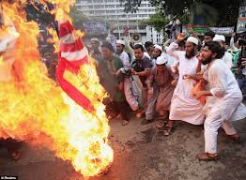
International Relations
UN, NATO, and most countries did no support the invasion.
Allies Germany and France not happy with US
Worldwide, Muslims opinion turned against US

Slide 18
History repeats itself…
As happened in Vietnam, Latin America, and Iran, US intervention brought unintended consequences.
Does intervening harm us in the long run?

Slide 19
Set up
Preemptive war debate
Number 1-6, get in to teams
Half support preemptive war, half do not
Mini debates
Class debate

Slide 20
Objectives
Understand why terrorism came about and how it has impacted America.
Explain why the US invaded Iraq and how it was perceived by the rest of the world.

