Slide 1
Agenda
Quiz
Ethnic Cleansing
The Arab-Israeli conflict

Slide 2
Objectives
Explain the difference between genocide and ethnic cleansing.
Explain what the Arab-Israeli conflict is.

Slide 3
TPS Report
"The government has ordered that all people of your ethnic background must leave their homes immediately. Those who don't leave will most likely be murdered by the armed forces patrolling the streets. Those who do leave also face the risk of being murdered, which you have seen with your own eyes. Many of the people in your city, including some of your family members, have not been seen for days. How do you feel about this situation? What fears and questions do you have? What must you leave behind as you are driven away from your home?"

Slide 4
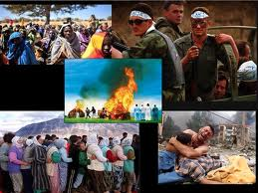
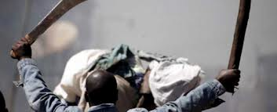
Ethnic Cleansing
Ethnic conflict has been around for a long time.
Can you think of any that we have discussed in this class?

Slide 5
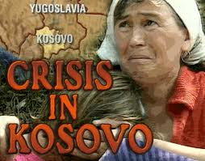
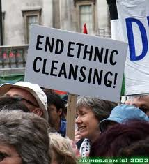
A new name…
In 1999, the world recognized a new type of ethnic violence.
Serbia was accused of “ethnic cleansing” in Kosovo

Slide 6
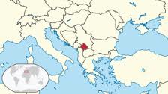

Slide 7
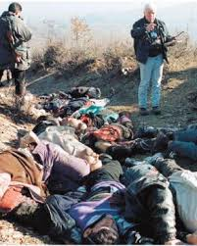
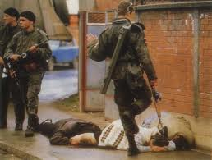
Details…
Christian Serbs were brutally forcing Muslims of of Serbia.
Killed many in the process.

Slide 8
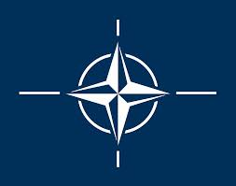
What does NATO stand for?
Not Aligned To Others
North American Trade Organization
North Atlantic Treaty Organization
Northern Alliance Tweeting Others

Slide 9
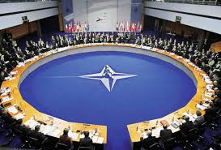
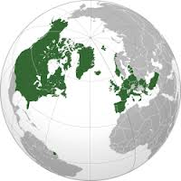
What does NATO stand for?
Not Aligned To Others
North American Trade Organization
North Atlantic Treaty Organization
Northern Alliance Tweeting Others

Slide 10
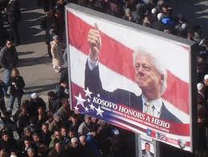
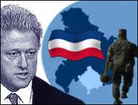
NATO involved.
President Clinton urged NATO to let US bomb Serbian forces to stop ethnic cleansing.

Slide 11
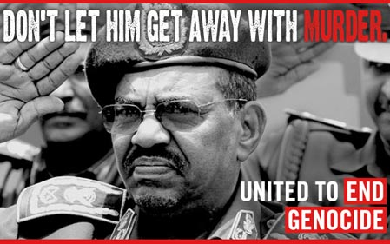
Does the world have a moral responsibility to stop atrocities like genocide or ethnic cleansing?

Slide 13
Who gets to decide when war will be waged to enforce morality?
Should it be international organizations like the United Nations or NATO or individual countries like the U.S. or China?

Slide 14
181. Arab-Israeli Conflict
After WWI, Britain took control of Middle East
Encouraged Jews to move to their ancient homeland in Palestine
Zion: A name for the Biblical land of Israel

Slide 15
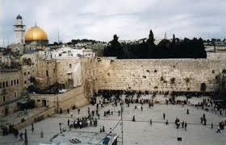
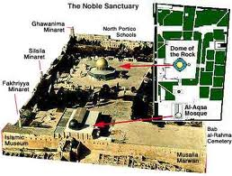
Claims to the Land
Israelis
Palestinians
Ancestors lived in area nearly 2000 years ago
Jerusalem home to most important Jewish site: the Western Wall
Palestinians have been living in the region for nearly 2000 years
Jerusalem is home to 3rd most important Muslim site: Dome of Rock/Al-Aqsa Mosque

Slide 16
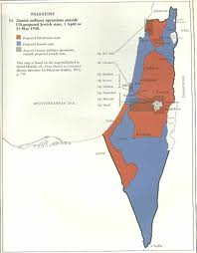
After WWII…
Britain left the region
Jews took over 2/3 of Palestine to create their new nation of Israel (in blue)

Slide 17
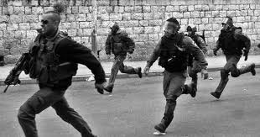
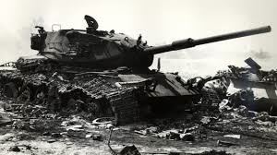
Reactions
Palestinians UPSET: Many become refugees.
Arab nations did not accept Israel as a nation. Series of wars from 1940s-1970s.

Slide 18
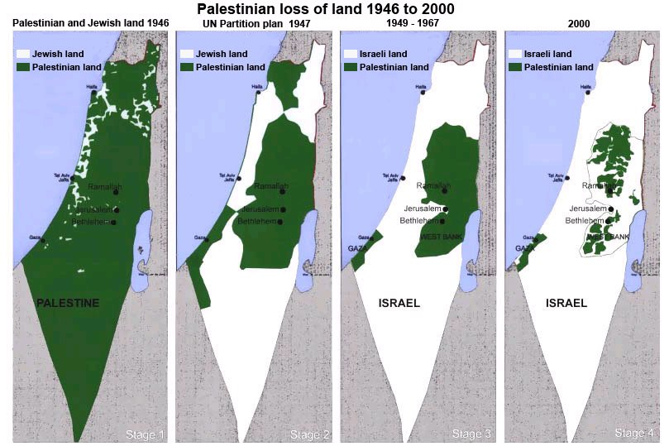
Israel wins the wars
Israel takes over more and more Palestinian land (in green).

Slide 19
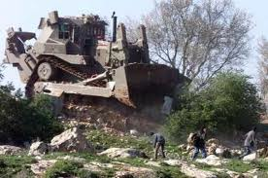
Israeli Settlements
Continue to take more Palestinian land

Slide 20
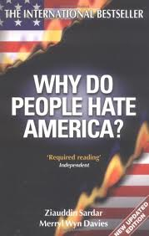
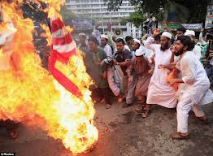
Arabs upset with the U.S.
For strongly supporting Israel

Slide 21
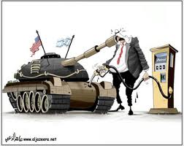
Juggling Act
US must balance support of democratic and Jewish Israel.
Must be friendly with authoritarian Arab nations that don’t like Israel but have huge oil supplies.

Slide 22
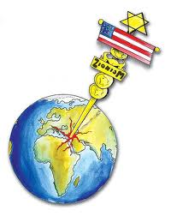
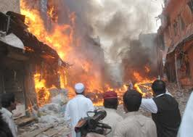
Dislike of U.S.
Poverty, hopelessness, and a history of imperialism lead to Arab resentment of the West.
Angry young men and women have been willing to become terrorists.

