Slide 1
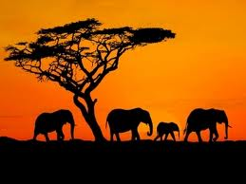
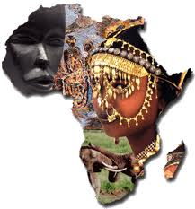
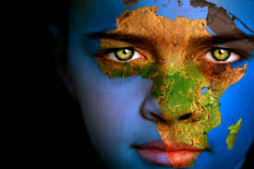
Agenda
HAND IN HOMEWORK!
Quiz
Latin America
Notes
Video
Africa
Notes
Hotel Rwanda

Slide 2
Objectives
Understand why Latin America has struggled and explain why they don’t have a favorable view of the US.
Explain how poverty has affected Africa.

Slide 3
178. Latin America
Western nations have long dominated economies of Latin America.

Slide 4
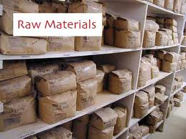
Colonial Pattern
Exported food and raw materials for manufactured goods.
Benefited white elites (2%)
Indigenous received little

Slide 5
Middle Class?
Very small middle class means always behind US and Canada.
Middle class growing since stability of the 90s.

Slide 6
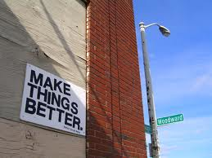
US in Latin America?
During Cold War, when Latin American politicians tried to make things better for their people, US labeled them communists.

Slide 7
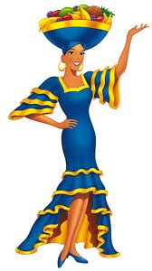
Guatemala
Democratic government took unused land from American United Fruit Company (Chiquita) and gave it to poor peasants.

Slide 8
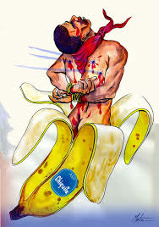
What happened next?
United Fruit Company was forced to give up land.
UFC demanded payment 16 times more than what Guatemala offered.
U.S. government got involved and overthrew the democratic government.
CIA led a coup to get rid of Guatemalan president.
Unrest leads to 200,000 Guatemalans killed, most Mayan Indians.

Slide 9
U.S. liked in Latin America?
U.S. goes on to overthrow several governments in LA.

Slide 10
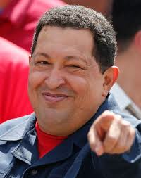
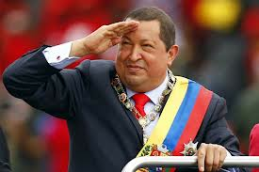
Hugo Chavez
of oil-rich Venezuela who complained, “The U.S. government sees itself as the owner of the world.”

Slide 11
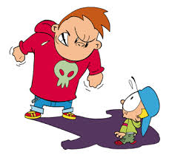
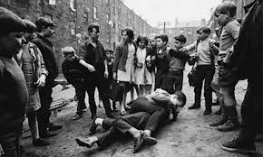
Anticipatory Set
Can you recall a time when you stood by silently while an injustice was occurring?
Notes:
􀂙 Did you consider intervening to stop the injustice while it was happening?
􀂙 What prevented you from intervening?
􀂙 What did you feel as you witnessed the injustice?
􀂙 If you were in the victim’s shoes, what would you have wanted from a bystander/witness?
􀂙 How did you feel afterwards? What did you do?
􀂙 If you could go back in time, what would you change about your reaction to the situation?
􀂙 How do you plan to respond to similar situations in the future?

Slide 12
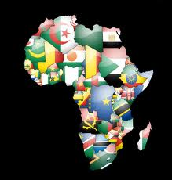
178. Africa
World’s poorest continent

Slide 13
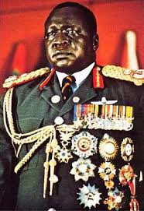
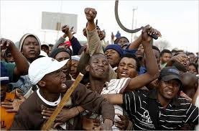
Stability?
NO!
Unstable governments meant no one wanted to invest in Africa.

Slide 14
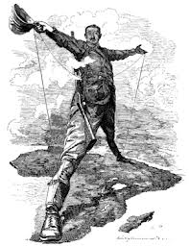
Scramble for Africa?
European powers carved up Africa regardless of ethnic groups.
Bad idea!

Slide 15
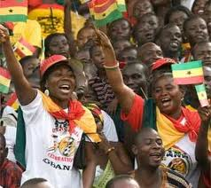
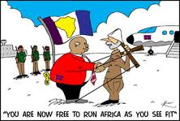
Independence!
African countries gained independence after WWII
Unable to overcome ethnic divisions

Slide 16
Newly independent countries had little experience in self-government.
yet they had to contend with tough problems like ethnic conflict, poverty, and corruption.
Most governments failed

Slide 17
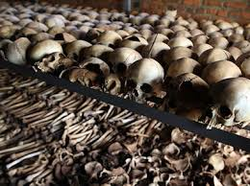
We are going to learn about a fairly recent event in our history in which a horrific injustice occurred while the world stood by silently. April 7th marks the anniversary of the genocide in Rwanda, when nearly one million innocent people were systematically slaughtered in a period of just under 100 days.

