Slide 1
Agenda
Anticipatory Set
Extreme Poverty
Third World Economic Development
Assignment

Slide 2
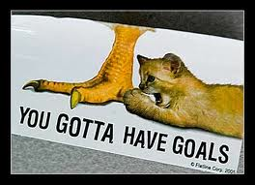
Objectives
Explain why extreme poverty is bad for everyone.
Understand what developing nations are, and the different economic models they have tried.

Slide 3
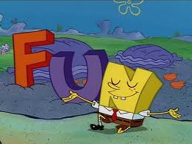
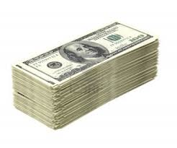
176. Anticipatory Set
How much money do you spend each month on fun? (New video games, movies, out to eat, gas!, shopping)

Slide 4
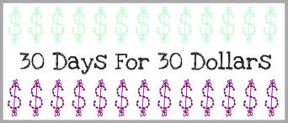
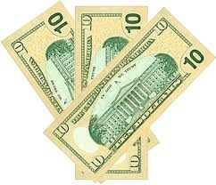
Continued
If your parents were going to put you on a budget for this month and you could only spend $30 on fun things what would you spend it on?

Slide 5
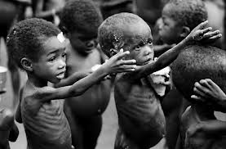
Poverty Stats
The Global Picture:
• One-third of deaths—some 18 million people a year or 50,000 a day—are due to poverty-related causes.

Slide 6
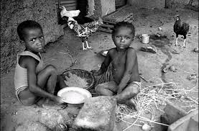
• 600 million of the world’s children live in absolute poverty.

Slide 7
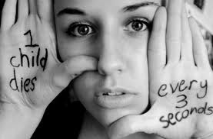
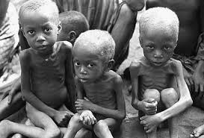
• Every year, almost 11 million children die before their fifth birthday. That’s 30,000 children a day. Most of these children live in developing countries and die from a disease or a combination of diseases that could be prevented or treated if the means were there. Sometimes, the cause is as simple as the lack of antibiotics for treating pneumonia or oral rehydration salts for diarrhea. Malnutrition contributes to over half of these deaths.

Slide 8
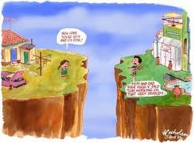
Gap getting wider
Gap between rich and poor widening

Slide 9
U.N.
Set goal to eradicate extreme poverty by 2025.

Slide 10
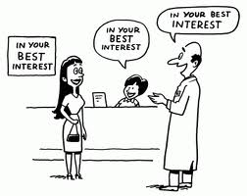
Why Helping is Good
Not just kindness, but in best interest of wealthy nations.

Slide 11
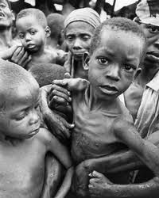
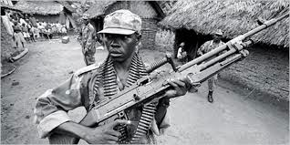
...
Poverty creates conflict that leads to war and terrorism.
Reducing poverty is the best way to promote peace.

Slide 12
Read it…

Slide 13
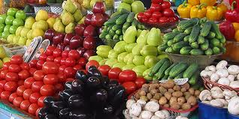
Anticipatory Set
Grocery Budget Activity.
Hand out worksheets.

Slide 14
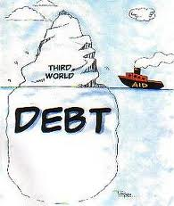
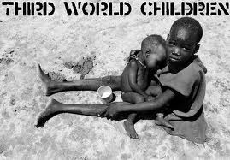
177. Third World Economic Development
The world’s poorest nations are termed developing nations or the Third World.

Slide 15
MAP

Slide 16
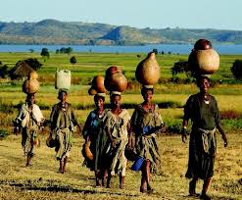
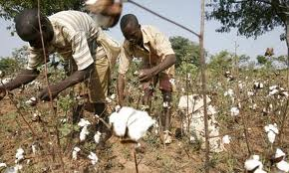
Who is poorest?
Most are in Africa, Asia, and Latin America and most are former colonies.

Slide 17
Economy?
Still trying to find a model that will work for them.

Slide 18
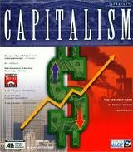
3 models have been tried:
Capitalism with no government control (India)

Slide 19
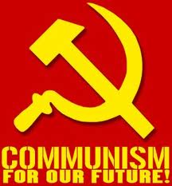
Opposite
Soviet Union and China did the opposite.
Communist governments completely control economy.
Government owns factories
Decides products and prices
Not Successful!!!

Slide 20
Third Model
Middle ground (Japan)
Authoritarian Japanese governments adopted capitalism, but promoted some industries and discouraged others.
Became one of the largest economies in the world.

Slide 21
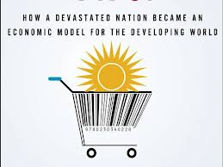
Japan Becomes Model
South Korea, Taiwan, and later China take after Japan’s economy.

Slide 22
Assignment
Read Stories
Answer Questions

