Slide 1
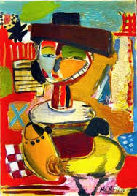
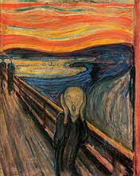
Agenda
Modern Art
Notes
Examples
Collapse of the Soviet Union
Notes
Video
Essay

Slide 2
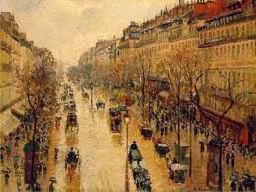
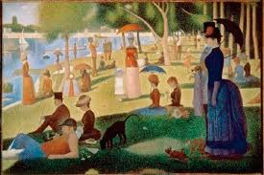
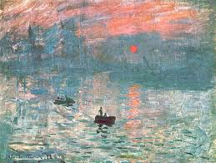
Modern Art
After modern art began with IMPRESSIONISM, art went many directions

Slide 3
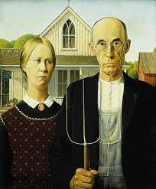
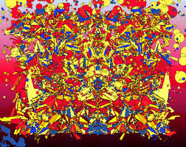
2 main categories of modern art:
Representational:
Abstract:

Slide 4
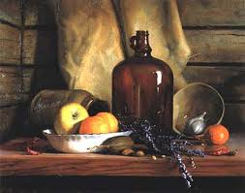
Representational
Objects through the artist eyes

Slide 5
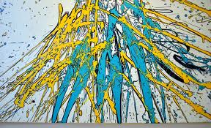
Abstract
no attempt to portray the outside world

Slide 6
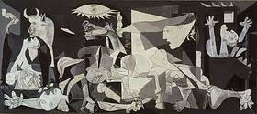
Modern Art continued…
Modern art reflects history (World Wars, threat of nuclear annihilation, loss of individuality via mass culture)
Example of modern art:
Picasso’s Guernica

Slide 7
Famous Modern Artists
Famous Artists

Slide 8
Playful art…
Most recognized art form today: movies

Slide 12
Read

Slide 13
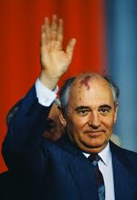
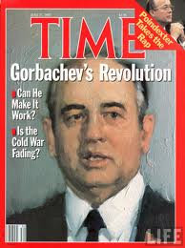
172. Collapse of the Soviet Union
1985 Soviet Union got a new leader Gorbachev
Knew changes needed to happen for progress

Slide 14
He knew communism sounded great but didn’t work because there was no incentive to work.

Slide 15
He called for more open democratic process
Reforms that looked like capitalism

Slide 16
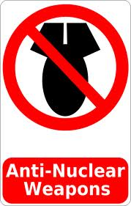
Signed treaties to limit nuclear weapons.

Slide 17
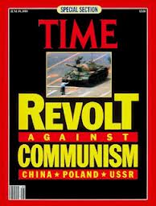
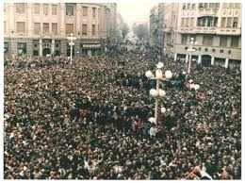
In a wave of rebellion, Eastern bloc overthrew communist governments.

Slide 18
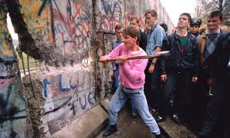
Berlin Wall Collapses

Slide 19
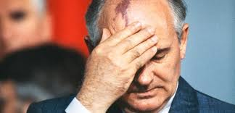
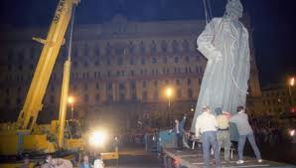
Soviet Union falling apart.
By 1991 SU ceased to exist.

Slide 20
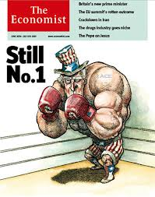
Cold War over.
U.S. lone super power

Slide 21
Essay

