Slide 1
Agenda
Quiz
Nuclear Arms Race
Notes
Video
Space Age
Notes
Video

Slide 2
Objectives
Understand the nuclear arms race and why it happened.
Explain how the race for space was impacted by nuclear arms race.

Slide 3
169. Nuclear Arms Race
After WWII, US only nation to have atomic bomb.
1949, USSR detonates atomic bomb

Slide 4
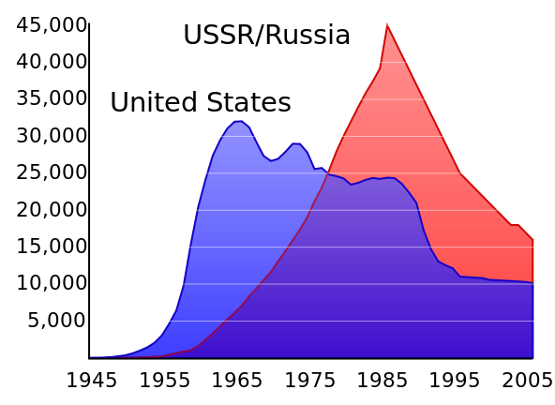
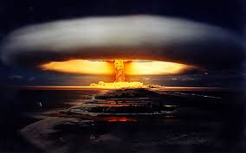
Ready, Set, Go!
Cold War competition turns into a race to build WMDs.

Slide 5
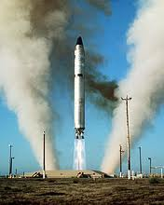
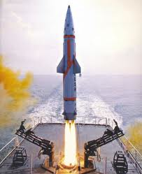
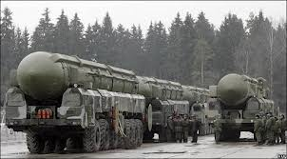
Advancing Technologies
Both superpowers developed missiles that could fly across the earth to deliver warheads.

Slide 6
Nuclear Arms Race Question
US and USSR were the most powerful nations in the world. Who was the third most?
Great Britain
France
China
Ireland

Slide 7
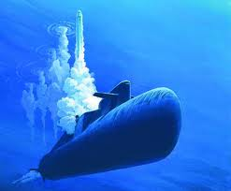
Nuclear Arms Race Question
US and USSR were the most powerful nations in the world. Who was the third most?
Great Britain
France
China
Ireland
Any Soviet or US submarine during the Cold War

Slide 8
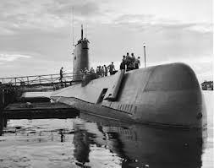
To the sea
Both develop nuclear subs.

Slide 9
Nuclear Arms Race Question 2
In the height of the Cold War, the US and the USSR possessed enough nuclear weapons to kill everyone on the planet how many times
13 times
37 times
143 times
200 times
373 times

Slide 10
Nuclear Arms Race Question 2
In the height of the Cold War, the US and the USSR possessed enough nuclear weapons to kill everyone on the planet how many times
13 times
37 times
143 times
200 times
373 times

Slide 11
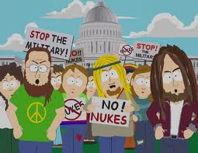
Tech to far…
Finally some weapons had become to terrible to use.

Slide 12
Anticipatory Set- Space Race
When there is a race, there is a winner. For each event determine who the winner was…
USSR or US?

Slide 13
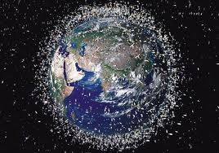
First person to orbit Earth
Notes:
US

Slide 14
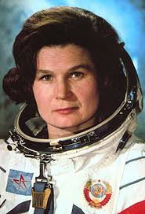
First woman in space
Notes:
USSR

Slide 15
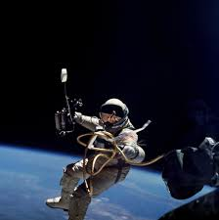
First person to step outside of his spacecraft while in outer space
Notes:
USSR

Slide 16
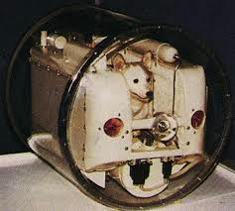
Send Laika, a dog, in to space
Notes:
USSR

Slide 17
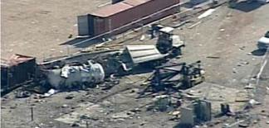
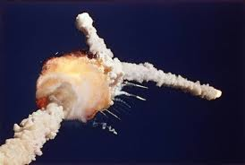
First to die en route to space
Notes:
US

Slide 18
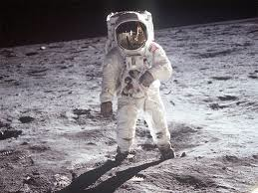
First man on the moon
Notes:
US

Slide 19
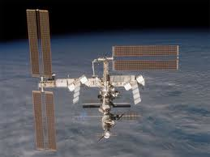
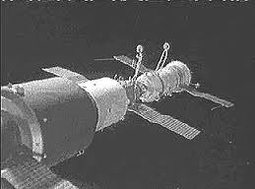
First space station.
Notes:
USSR

Slide 20
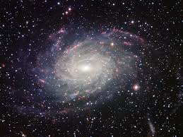
170 Space Age
Rivalry moves to outer space.
Space race tied to arms race.

Slide 21
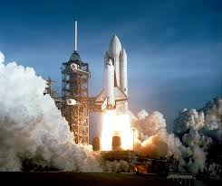
How?
Long range missile technology makes space flight possible.

Slide 22
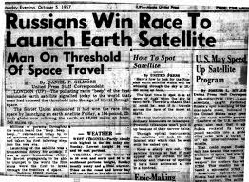
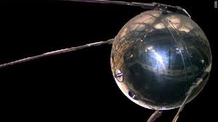
Space Age
Starts in 1957 with launch of Sputnik
US failed early

Slide 23
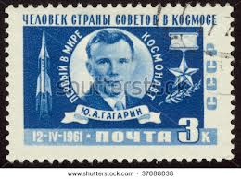
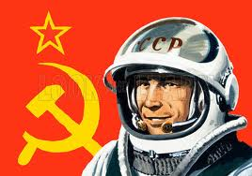
1961
USSR gets first man in to space
America follows suit

Slide 24
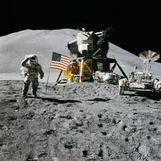
US takes lead
1969 Neil Armstrong becomes first human to set foot on the moon
A turning point in history?

Slide 25
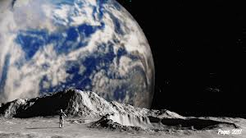
New Perspective
Humans got first good look of earth.
Biggest perspective change since Columbus.
We must protect Earth!

Slide 26
Full of life

