Slide 1
Agenda
Quiz
Containment
Notes
Video
Vietnam
Notes
Songs

Slide 2
Objectives
Understand the policy of containment.
Explain how the Korean war was an example of containment.
Explain the how the Vietnam War was viewed in America

Slide 3
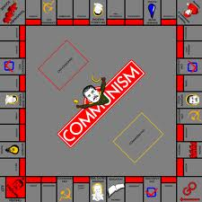
Anticipatory Set
CONTAINMENT

Slide 4
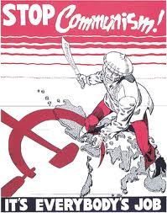
Discussion
What was Stalin doing in the Soviet Union?
In your own words, what does containment mean?

Slide 5
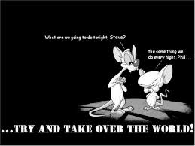
166. Containment
Communist now control Soviet Union, China, Eastern Europe.
More people live under communism then capitalism

Slide 6
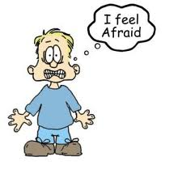
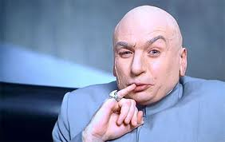
The West
Afraid of communist world domination and downfall of democracy.

Slide 7
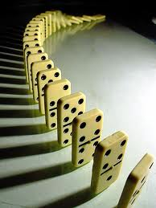
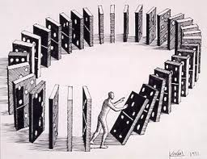
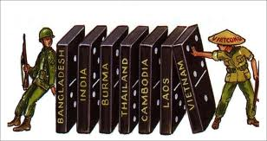
Domino Theory
Feared that if one country turned communist then more would topple like dominoes.

Slide 8
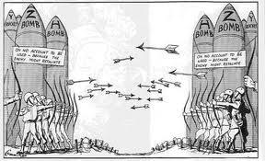
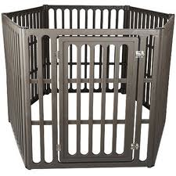
Containment
US set out to do everything to stop the spread of communism.

Slide 9
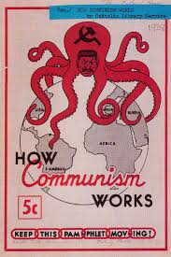
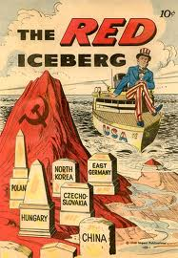
Propaganda
He might be a COMMUNIST...

Slide 10
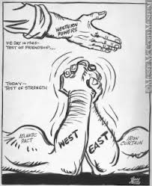
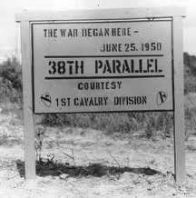
First Test for Containment
Communist North Korea (Soviets) invades South Korea (USA)

Slide 11
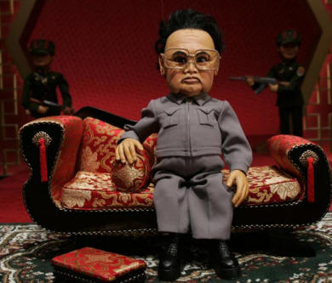
What is a Puppet Government?

Slide 12
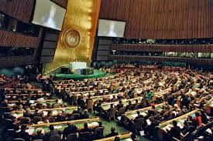
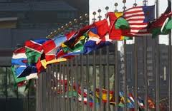
United Nations
Assembly of world nations formed after WWII to promote peace and cooperation.

Slide 13
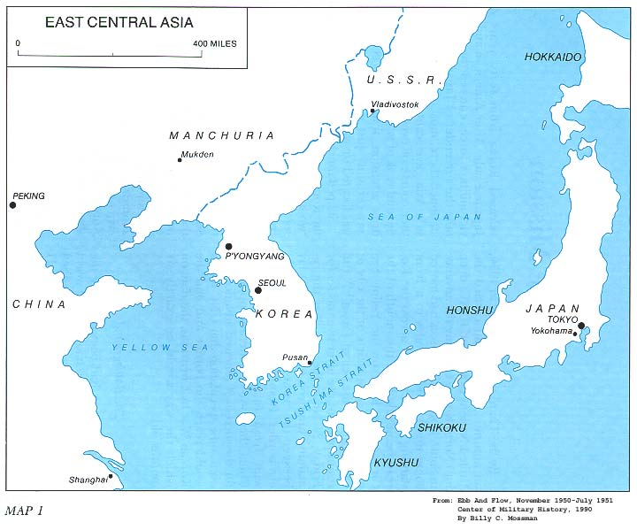
UN Vote
Soviet Union was not present, UN approves US resolution to send troops to Korea.

Slide 14
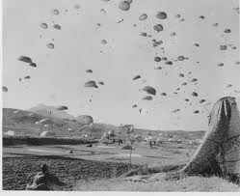
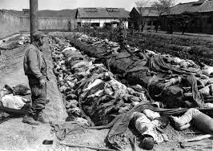
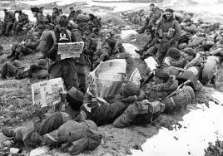
Korean War
North Korea
Soviet Union, China (1,000,000 troops)
South Korea
UN (Mostly USA)

Slide 16
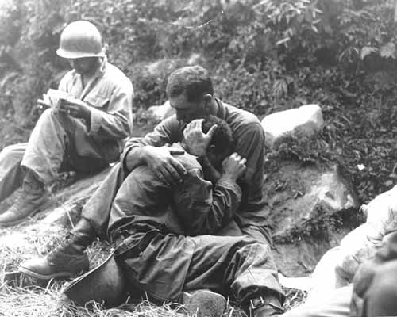
The Forgotten War
Lasted 3 years
Notes:
A grief stricken American infantryman whose buddy has been killed in action is comforted by another soldier. In the background a corpsman methodically fills out casualty tags. Korea. August 28, 1950.

Slide 18
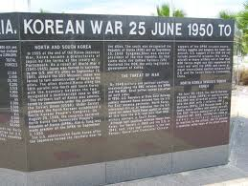
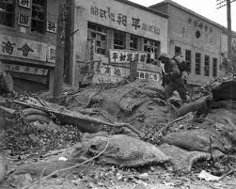
Korean War
Ends at 38th Parallel
About the same place it started.

Slide 19
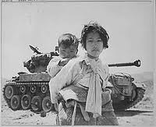
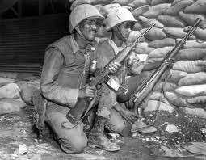
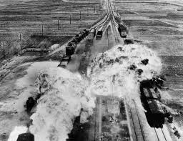
Korean War
Explained

Slide 21
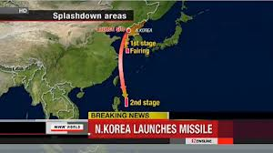
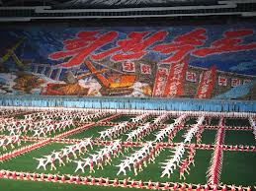
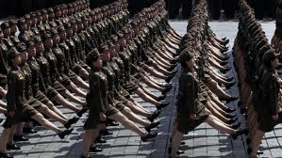
Korea Today
Threats today?
South Korea Ready

Slide 22
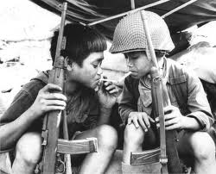
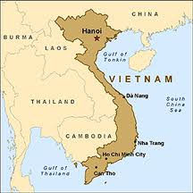
167. Vietnam War
Before WWII Vietnam was a French colony.
During the war, Vietnamese communist fought the Japanese and rescued Americans

Slide 23
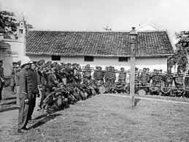
After WWII
Vietnamese fought France for independence and won. (US helped France)

Slide 25
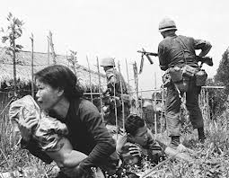
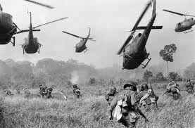
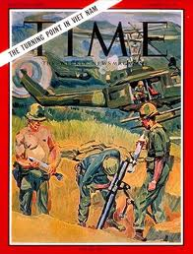
U.S. Involvement
Sets up anti-communist government in S. Vietnam
1965 defeat was close, so U.S. send ½ million troops to Vietnam

Slide 26
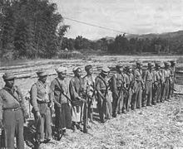
Vietnam War
Guerrilla war- no front lines
Largely unpopular in the U.S.

Slide 27
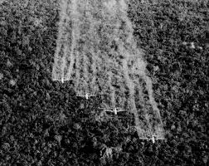
Agent Orange
Agent Orange

Slide 28
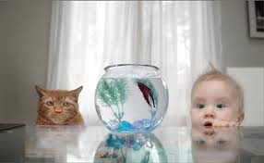
Same Conflict Different Wars?
Communists saw it as an independence movement
U.S. saw it as communism spreading

Slide 29
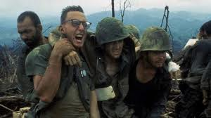
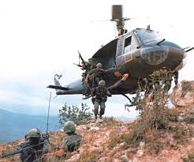
End of War
U.S. withdrew in 1973 defeated.

Slide 31
Song Analysis

