Slide 1
Agenda
Map Quiz!
Gandhi
Notes, Videos
People’s Republic of China
Notes, video
Discussion

Slide 2
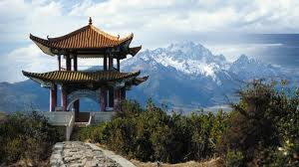
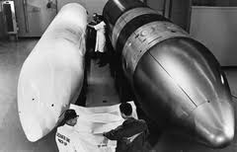
Objectives
Understand how China got to be the way it is.
Explain who started the Cold War.

Slide 3
Map Quiz
LOCATIONS: Eastern Europe, Berlin, Pakistan, Taiwan, Korea, Vietnam, Afghanistan, Portugal, Australia, Puerto Rico

Slide 4
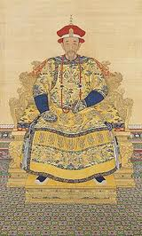
163. People’s Republic of China
What was the last dynasty to rule China?

Slide 5
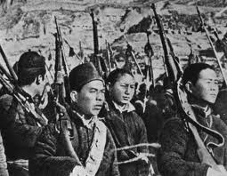
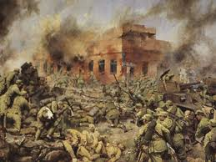
Post Qing?
Four decades of turmoil
Civil War after WWII

Slide 6
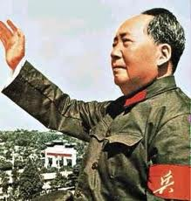
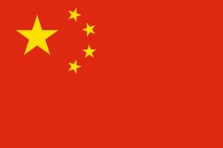
Winners
Communists led by Mao Zedong
Established People’s Republic of China 1949

Slide 7
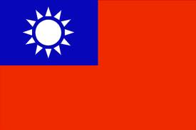
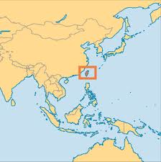
Losers?
Fled to Taiwan
Set up ANTI-communist government that still exists

Slide 8
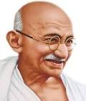
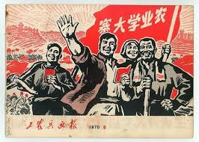
Independence Movements?
India, led by Gandhi (British trained lawyer)
China, a PEASANT revolution

Slide 9
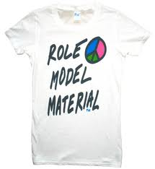
A Model
China, a model for other peasant revolutions
Vietnam, Cuba

Slide 10
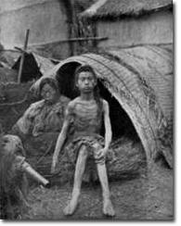
Mistakes
Mao’s government mismanaged food production.
Left 30-50 million dead

Slide 11
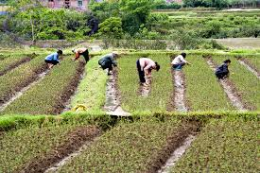
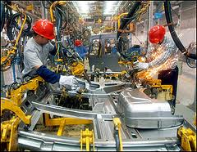
Benefits
Chinese communists improved agriculture and industrial production

Slide 12
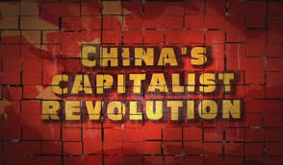
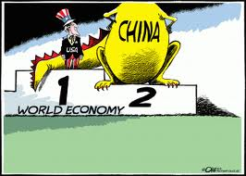
Post Mao
Mao dies in 1976
Economy becomes more capitalist
But still authoritarian

Slide 13
READ IT

Slide 14
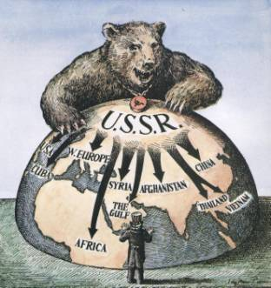
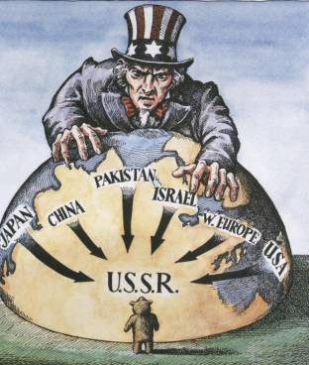
164. The Cold War

Slide 15
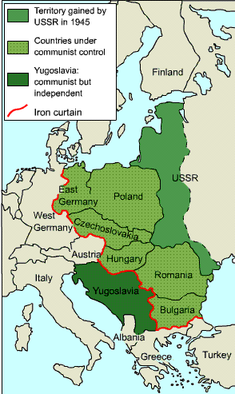
After WWII, Soviet Union takes over 8 Eastern European countries.
A buffer zone in case Europeans want to invade Russia again in the future.

Slide 16
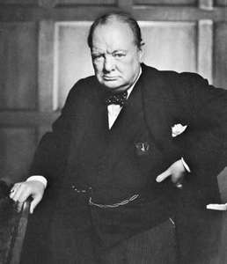
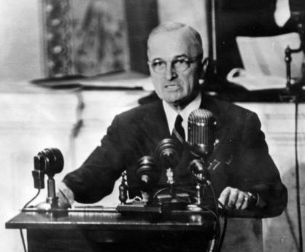
Responses to Soviet takeover of Eastern Europe
1946: Churchill’s ”Iron Curtain” speech
1947: Truman Doctrine (Aid to Greece and Turkey)
1948: Marshall Plan

Slide 17
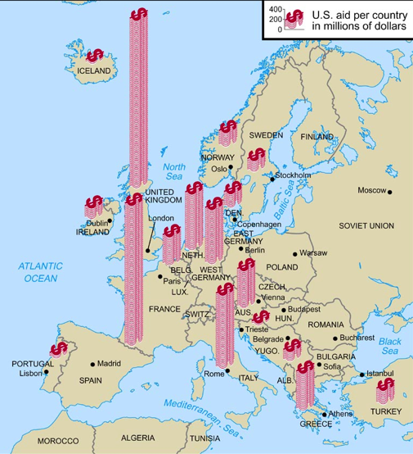
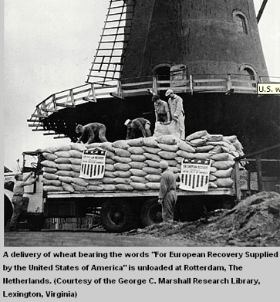
-The Marshall Plan, 1947
-Money went to European nations so they
Wouldn’t turn communist.

Slide 18
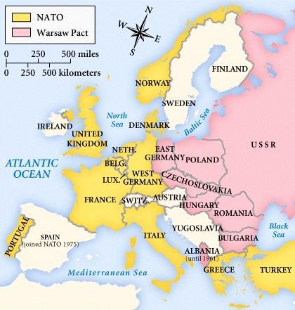
Alliances following WWII
NATO Alliance (U.S. and Western European democracies)
Warsaw Pact (Communist Soviet bloc)

Slide 19
So, who started the Cold War?

