Slide 1
Agenda
Objectives
Map locations for new unit
Independence Movements
Notes
Gandhi
Notes
Video

Slide 2
Overview
Overview: It was a different world after World War II. Colonialism was no longer acceptable, and before long most of the world’s colonies had gained their independence from foreign rule. At the end of World War II, Western Europe was no longer the dominant region of the world. It had been replaced by two new “superpowers,” the capitalist United States and the communist Soviet Union. Soon the superpowers were locked in a 45-year-long political, economic, and military struggle called the Cold War, which divided much of the world between pro-Soviet and pro-American camps. The superpowers never fought each other directly, but capitalist and communist forces fought “Proxy wars” in places like Korea, Vietnam, and Afghanistan. The Cold War led to a nuclear arms race between the superpowers and a space race that sent men to the moon.

Slide 3
Objectives
Locate this units map locations.
Explain Independence movements
Understand the importance of Gandhi

Slide 4
Unit 11 Map Locations

Slide 5
161. Independence Movements
Notes:
Read and highlight

Slide 6
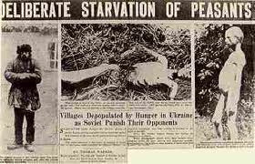
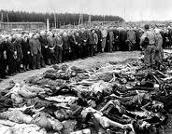
20th Century continues…
We saw the worst of human nature during the 20th Century.

Slide 7
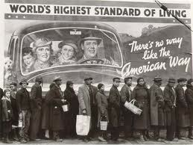
Good?
Humans made great strides.
Medicine
Increased life expectancy
Standard of living

Slide 8
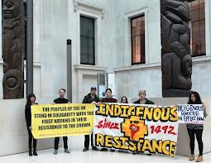
Colonialism?
NO NO!
Colonialism comes to an end.

Slide 9
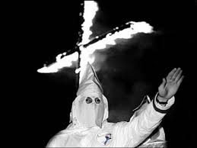
Review Question
What type of thinking led to imperialism?

Slide 10
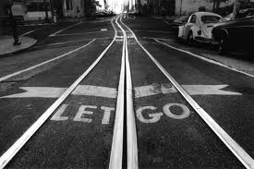
Post War
After the horrors of Hitler and Nazis, racist ideas no longer acceptable.
Western powers let colonies slip away.

Slide 11
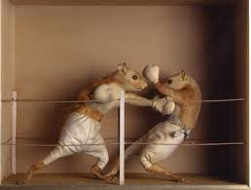
Independence
Some had to fight for independence.
Others won freedom peacefully.

Slide 12
Post WWII
Within 15 years, most colonies were free!

Slide 13
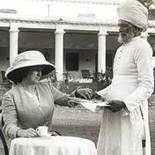
162. Gandhi
British had ruled India since 1800s
They were very oppressive.

Slide 14
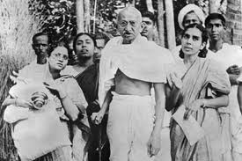
Gandhi
Fought this oppression with NONVIOLENCE
He and his followers adopted civil disobedience.

Slide 15
they disobeyed unfair British laws, endured police beatings, and went to prison
Showed the world how unjust the British were

Slide 16
Popularity?
Gandhi’s independence movement gained support after Amritsar massacre
. Amritsar Massacre—British opened fire on peaceful crowd killing many

Slide 17
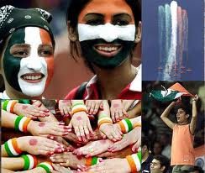
Independence?
India was finally set free after WWII
First of many countries to win freedom

