Slide 1
Agenda
Quiz
Finish Cinderella man
Fascism
Notes
Highlight
Mass Culture
Notes (Propaganda)
Disney video

Slide 2
Objectives
Describe what a fascist government is and how it differs from Communism
Understand Mass Culture and how it has changed since the Industrial Revolution.

Slide 3
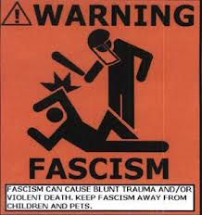
150. fascism
A political movement that opposed communism and democracy, but favored violence, war and promoted nationalism and obedience to the state.

Slide 4
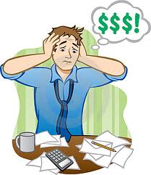
Italy
Had economic problems.
Fascism was the answer!

Slide 5
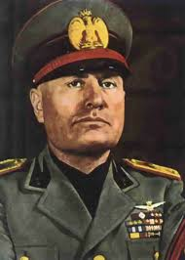
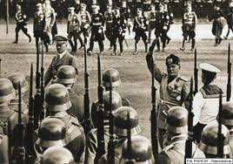
Benito Mussolini
Made himself dictator.
Took over media
Set up secret police.

Slide 6
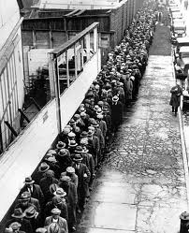
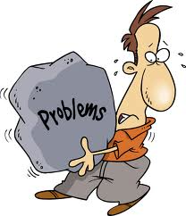
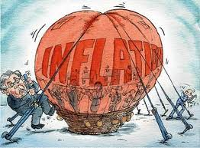
Germany
Many problems.
50% unemployment
Inflation- took bags of money to buy bread

Slide 7
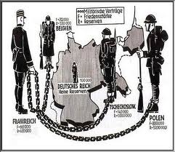
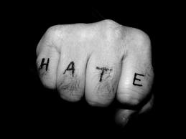
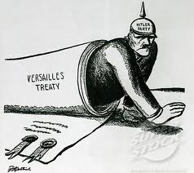
Treaty of Versailles
Humiliated Germany
Very harsh
Deeply hated in Germany

Slide 8
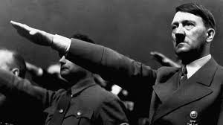
Fascism is the Answer!
Adolf Hitler leader of fascist Nazi Party
Great public speaker, very popular with nationalist
Democratically voted leader!

Slide 9
Hitler’s Successes?
5 years unemployment went from 6 million to almost zero.
Standard of living rose

Slide 10
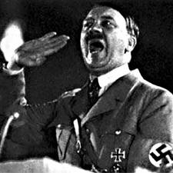
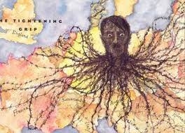
German Parliament
Gave absolute power to Hitler

Slide 11
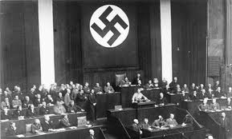
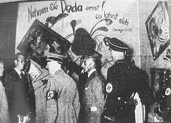
Hitler
Banned political parties (except Nazis)
Set up secret police.
His enemies were killed, tortured, or imprisoned

Slide 12
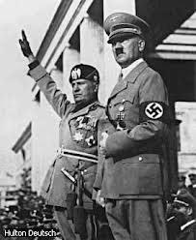
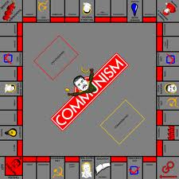
Fascism vs. Communism
Obedience to the state
Favors violence and war
No one challenges the state
No classes
all equal
Strictly economic

Slide 13
Read It

Slide 14
Mass Culture
Before industrial revolution, culture experienced alone.

Slide 15
Mass Culture
With the Industrial Revolution came mass produced media.
Media= movies, radio, music, newspaper, magazines
Sports teams are created
These things created mass culture

Slide 16
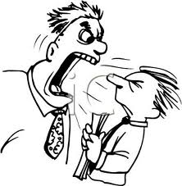
Critics of Mass Culture
People spectators rather than participants
Mass culture can be controlled by appealing to emotion rather than reason

Slide 17
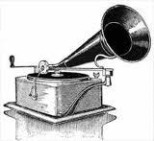
Nazi Mass Culture
State took control of radio stations and film.
They used PROPAGANDA
A systematic effort, usually by the government, to spread ideas or beliefs

Slide 18
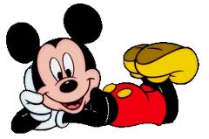
Did the US use propaganda?
Disney cartoon ANTINAZI propaganda
http://www.youtube.com/watch?v=ASW3UCc17AI

Slide 19
Follow up
What type of source is this?
What are your general thoughts on this cartoon?
What was the aim of this cartoon?

Slide 20
Read 151 Mass Culture
Highlight key points
We have already answered why it is important

Slide 21
Review IT
Describe what a fascist government is and how it differs from Communism.
Understand Mass Culture and how it has changed since the Industrial Revolution.

