Slide 1
Agenda
Review Communism/ Treaty of Versailles
Social Reform Laws
Notes
The Great Depression
Notes
Video
QUIZ FRIDAY

Slide 2
Objectives
Explain why the workers did not revolt as Karl Marx said they would.
Understand why the Great Depression happened.

Slide 3
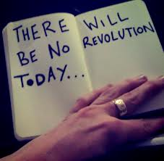
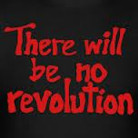
148. Social Reform Laws
Workers did not start a revolution like Marx predicted
Their circumstances improved

Slide 4
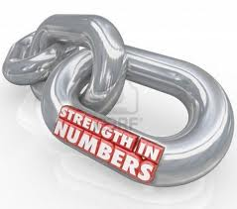
Strength in Numbers
Formed Labor Unions
Shut down factories until owners agreed to better conditions/pay

Slide 5
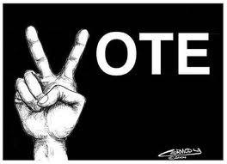
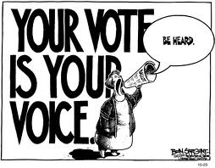
Suffrage
Early 1900s all men could vote
Politicians had to listen

Slide 6
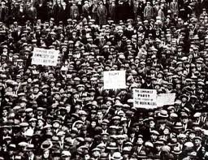
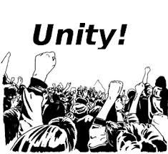
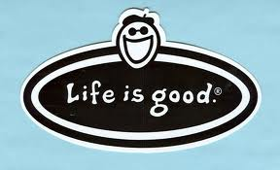
Government Response
Passed social reform laws to improve lives of workers.

Slide 7
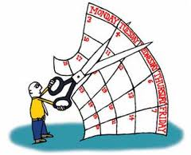
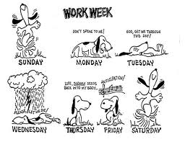
Examples of laws…
Germany: insured workers against accidents and sickness, limited hours worked, old-age benefits.
British: Stopped child labor under age 9, free education, first with 5 ½ day work week

Slide 8
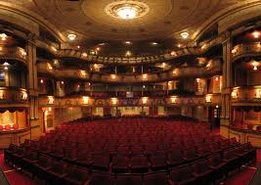
MORE FREE TIME!

Slide 9
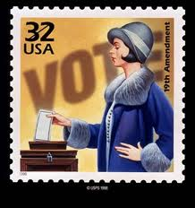
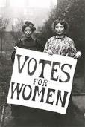
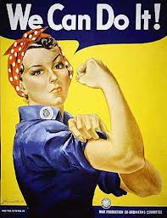
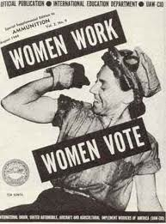
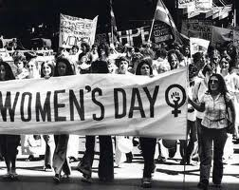
Women’s Rights?
By 1939 women in U.S. and 31 other countries could vote!

Slide 10
READ IT!

Slide 11
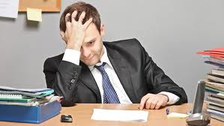
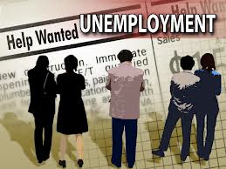
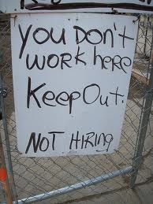
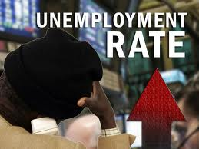
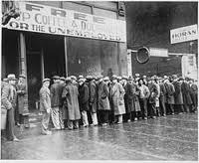
149. The Great Depression
Got worse for workers again in 1930s.

Slide 12
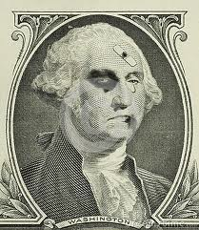
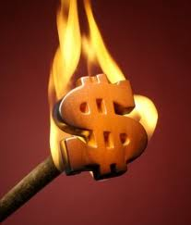
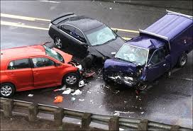
Causes
Weak economies after WWI
Stock Market crash of 1929

Slide 13
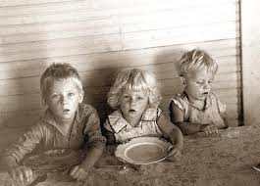
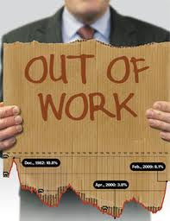
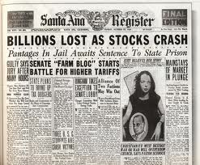
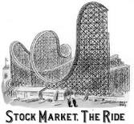
Average person…
Lost job, life savings.
Went hungry…

Slide 14
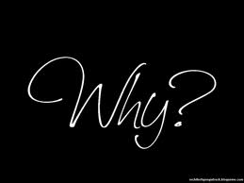
Crisis of Meaning
Millions died now millions can’t find work

Slide 15
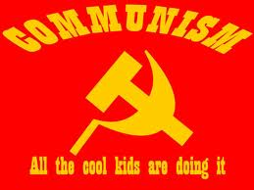
Wanted change…
Capitalism wasn’t working for many.
Looked to Soviet Union (equal society)

Slide 16
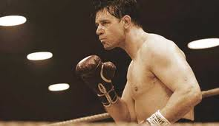
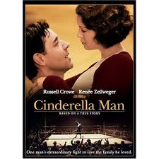
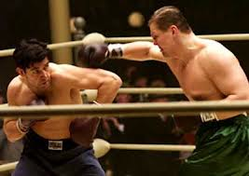
Cinderella Man

Slide 17
Cinderella Man
Character Groups:
1) Jim Braddock
2) Mae Braddock
3) Joe Gould
4) 3 Braddock Children

Slide 18
Shadow your character throughout the movie. What happens to them?
How do they change?
How does their role in society change?
What perspectives are not shown in the film?

