Slide 1
Agenda
Review last class
Crisis of Meaning
Notes
Communism
Notes
Assignment

Slide 2
REVIEW!!

Slide 3
Objectives
Understand the social impact WWI had on society.
Explain how communism came about.

Slide 4
TPS
Is human nature evil or good?
Explain

Slide 5
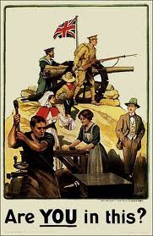
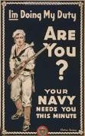
146 Crisis of Meaning
WWI first total war

Slide 6
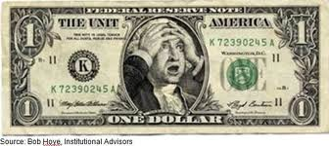
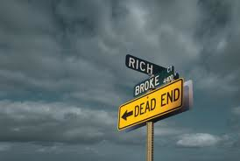
The point?
Destroyed a generation.
Left weak economies, high unemployment.

Slide 7
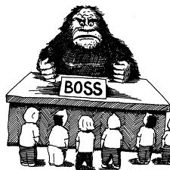
Colonies?
Began to wonder why Europe controlled them.
Couldn’t control themselves.

Slide 8
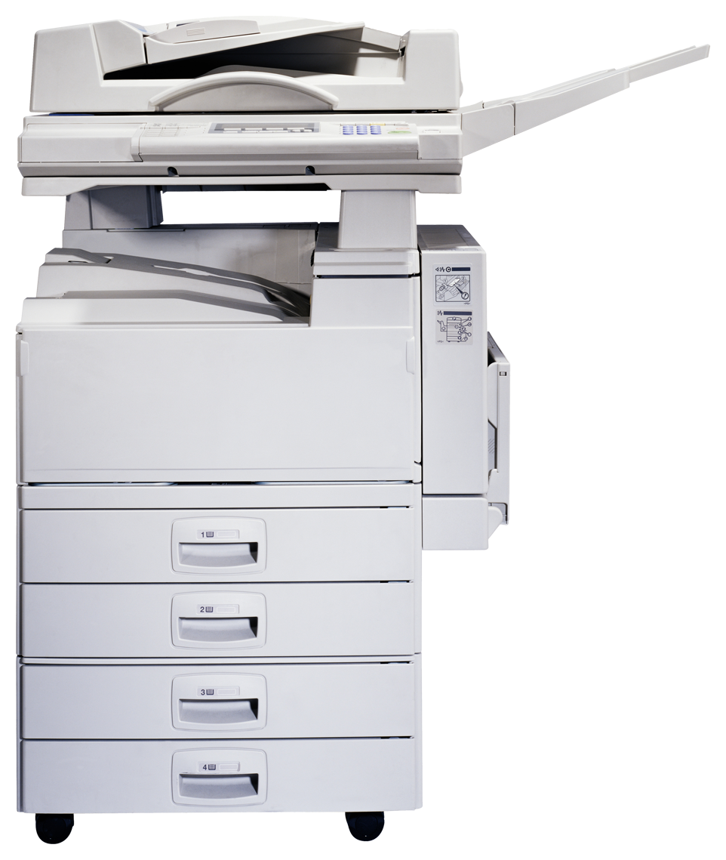
Technology=Good?
Some saw link between technology and destruction.

Slide 9
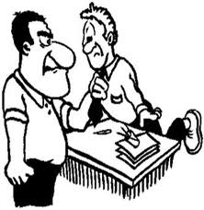
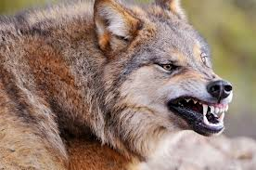
Sigmund Freud
Father of psychology
Found humans had an instinct for aggression and self destruction.

Slide 10
READ

Slide 11
147 Communism
Anticipatory Set
I will read some statistics about the state of the world today. You go to a the boards that best fit your beliefs
Governments should do something to changes this.
Governments should not do anything to change this.
Unsure
May be asked to defend your spot.

Slide 12
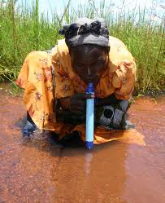
More than 25% of the worlds population does not have access to safe drinking water.

Slide 13
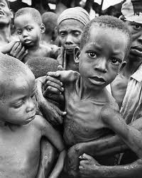
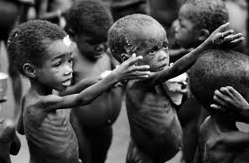
If all the food in the world were divided evenly, everyone would have enough to eat. Because it is not divided evenly, 60% of world’s population is always hungry, 16% go to sleep often without enough to eat, and only 24% always have enough to eat.

Slide 14
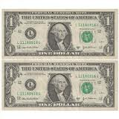
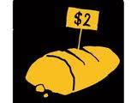
More than 2/3 of the world’s population has to survive on less than $500/year (or less than $2/day)

Slide 15
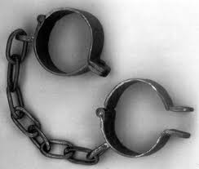
27,000,000 people in the world TODAY live in slavery.

Slide 16
The richest 350 people in the world have incomes greater than the poorest 45% of the world’s population combined.

Slide 17
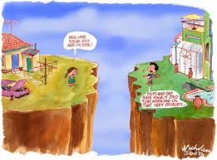
In many countries today (including the U.S.) the gap between the rich and poor is growing wider (rich becoming richer and poor becoming poorer)
Notes:
Communists would answer yes to all of these questions.

Slide 18
Communists
would answer yes to all of these questions.

Slide 19
What is communism?

Slide 20
Need to understand SOCIALISM
What was/is socialism?

Slide 21
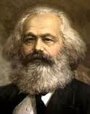
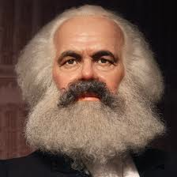
Karl Marx
Invented modern socialism in 1800s because the working-class poverty of the Industrial Revolution

Slide 22
KM
Said workers would start a revolution and overthrow capitalism.

Slide 23
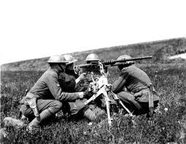
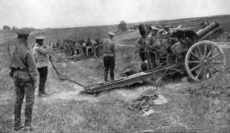
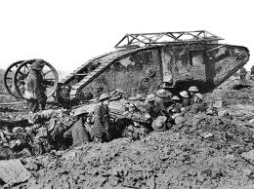
Russia
Vladimir Lenin thought Russia was ready for a socialist revolution.
Chance came in WWI.

Slide 24
Russia and WWI
Didn’t go well.
No leaders, food or equipment.

Slide 25
Tsar overthrown

Slide 26
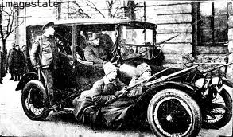
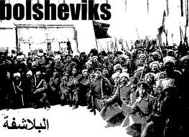
Lenin and the Bolsheviks
Promised peace, land and better working conditions.

Slide 27
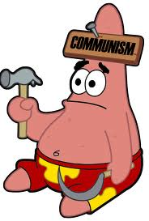
Communism born…
Extreme form of socialism that blends Marx’s economic ideas with Lenin’s ideas about a revolution.

Slide 28
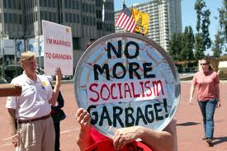
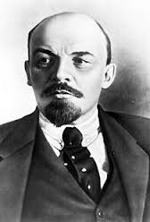
Issues?
Lenin executed 1,000s that opposed communism.

Slide 29
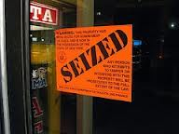
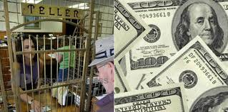
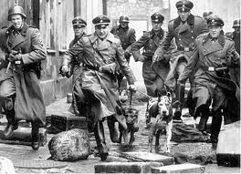
Took over…
Banks and industries.
Banned political parties
Set up secret police

Slide 30
Russia’s New Name
Union of Soviet Socialist Republics
Soviet Union

Slide 31
READ IT!

Slide 32
REVIEW IT- Hand in
How did people view WWI?
What will win out in the end aggression or reason?
What is communism similar to?
Who started communism?
What is bad about communism?

