Slide 1
Agenda
QUIZ!
PASS BACK PAPERS
Read/Highlight Lusitania
Watch Treaty of Versailles Video
Treaty Simulation
Wrap up
Read, highlight Treaty of Versailles

Slide 2
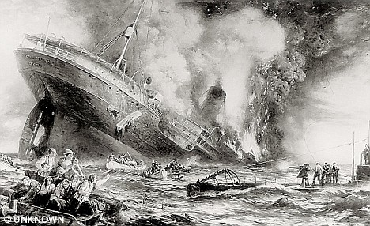
Lusitania
What the heck happened?

Slide 3
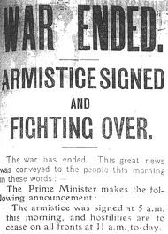
Objectives
Explain how WWI ended.
Understand the significance of the Treaty of Versailles.

Slide 4
145 Treaty of Versailles

Slide 6
Treaty of Versailles Video
Watch video
What was going on?
Who were the main players?
What did they want?

Slide 7
Treaty Simulation
You MUST play your part.

Slide 8
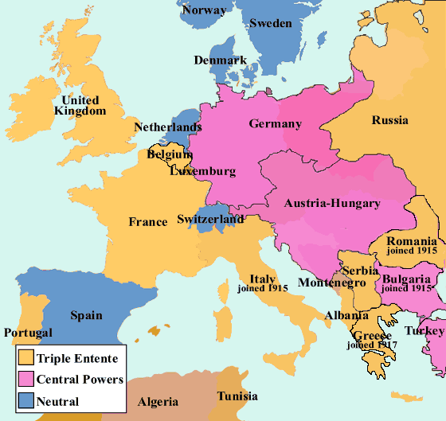
1914 Map of Europe

Slide 9
After the Treaty Map of Europe

Slide 10
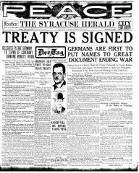
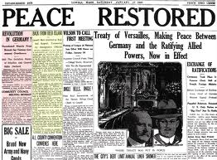
Treaty of Versailles
Ended war between Germany and the allies

Slide 11
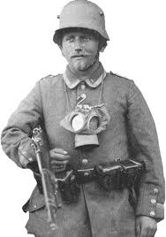
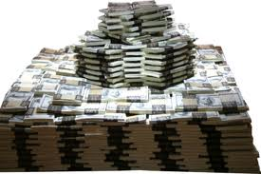
Results
Took away Germany’s colonies
Limited their army and navy
Forced to pay for the war

Slide 12
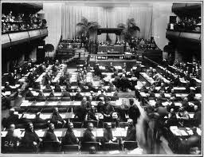
League of Nations
Assembly of 60 nations
NO MORE WAR!

Slide 13
U.S. Senate didn’t approve the treaty
Senators wanted to avoid involvement in Europe’s squabbles.
Good luck with that!

Slide 14
Read and Highlight
Treaty of Versailles

