Slide 1
Agenda
Review your country information
Elect officials
Simulation
End Game
Closure Questions

Slide 2
Election
Decide who is secretary of state
Ambassadors?

Slide 3
Confidential State Papers

Slide 4
Hints!
HINT: Have the ambassadors work independently, but still communicate with each other as well as their country.
HINT: Students that remain at desks should watch the interactions in the room. Who is talking to whom?
HINT: Ambassadors should have a pretext to talk to other groups, even if false. This allows espionage - the ability to hear and/or prevent other conversations.

Slide 5
Objectives
Students will create a workable and enforceable Alliance system designed to ensure the survival of their respective country.
Students will be able to explain how alliances made before World War One influenced the conduct of the war and its outcome.

Slide 6
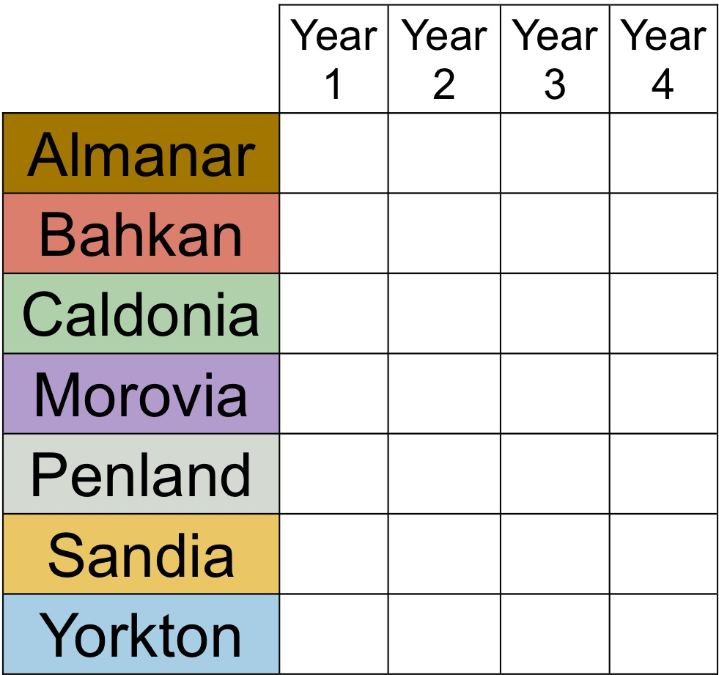
Game
W-Y
W-M
P
P
P
P
W-M
P
W-M
W-M
W-B
P
W-M
W-M
W-C
W-M
W-M
W-Y
P
W-M
W-M
W-S
W-A
W-A
W-Y
P
W-A
W-A
Notes:
Morovia cut in half must pay for the war
Land divided by B, C, S, M B largest portion
Almanar no longer exists divided evenly between Y, C B, Sandia get economic gain from Almanar

Slide 7
W-B
W-P
W-B
W-B
W-B
W-P
W-B
W-S
P
P
P
W-S
W-P
P
W-S
W-P
W-S
W-S
W-B
W-P
W-S
P-
P
P
P
P
P
P
Notes:
Sandia was over thrown in a revolution lost a quarter of its land. Its new name is Aidnas
Bahkan was reduced to a third of its original size and forced to pay for the cost of the war
Penland gainsbiggest territory in Bahkan and Sandia with yorkton and caldonia gaining land as well. Almanar gains no land but still exists.

Slide 8
Closure
How do you feel your country did? Did you accomplish what was in the best interest of your country? Explain.
Were there some groups you could rely on? Explain.

Slide 9
Were there some groups you could not trust? Explain.
What does your group wish would have happened differently?

Slide 10
Did you want a war? Why or Why not?
What are the advantages of an alliance system?
What are the disadvantages of an alliance system?

