Slide 1
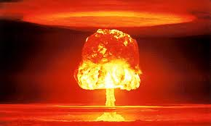
Agenda
Review
Finish Unit
Hiroshima
Notes
Video
Debate
Start Third Essay!!

Slide 2
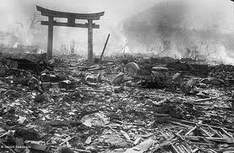
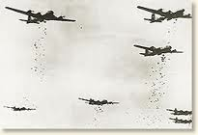
Hiroshima #160
Fighting in the Pacific continued
American bombers began to strike Japanese cities

Slide 3
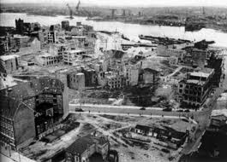
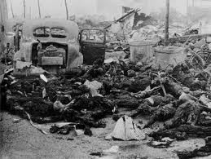
Japan on the verge of collapse but would not surrender

Slide 4
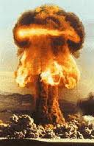
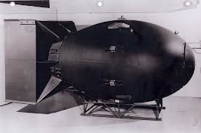
Atomic Bomb
While the war was taking place, scientist developed the Atomic Bomb

Slide 5
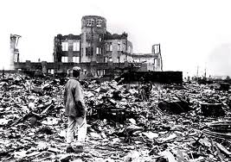
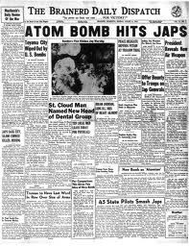
President Harry Truman ordered the atomic bomb to be used August 6, 1945
First Hiroshima, then Nagasaki three days later
Japan surrenders

Slide 6
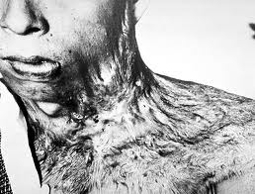

Slide 7
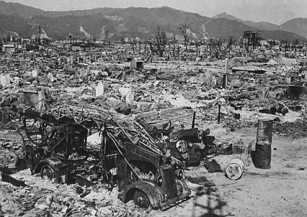

Slide 8
WWII Causalities
50 million dead
Of these, 2/3 are civilians
Atomic bomb meant future world war might kill everyone?

Slide 9
Controversy: Debate
The United States should not have dropped the bomb.

Slide 10
Groups of 4
2 will be for
2 will be against
If you are working and debating 10 points
Talking about something else 0 points
After each round one team will debate to the entire class
After the debate each group must talk it out and decide which side had the best argument.

Slide 11
Order of Debate
Position 2 minutes PRO
Clarifying questions
Position 2 minutes CON
Clarifying Questions
Second Position 2 minutes PRO
Clarifying Questions
Second Position 2 minutes CON
Clarifying Questions
Discussion and Consensus

