Slide 1
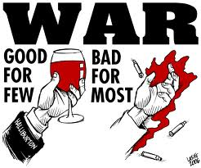
Agenda
Blitzkrieg
Notes
Video
WKSHT
Simulation
WWII
Notes
Video

Slide 2
Lesson Objectives
To understand what Blitzkrieg was and how it worked
To consider why Blitzkrieg tactics was so successful
Explain why the United States entered WWII

Slide 3
BLITZKRIEG MEANS LIGHTNING WAR – IT WAS AN ATTACK USING BOTH GROUND TROOPS AND AIR FORCE WORKING TOGETHER TO HIT TARGETS

Slide 4
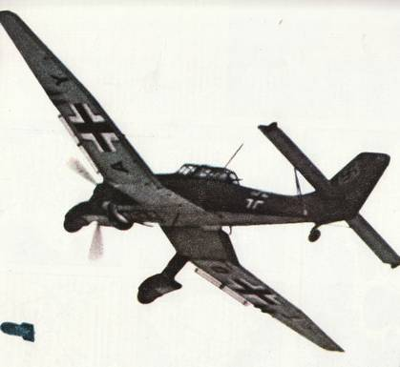
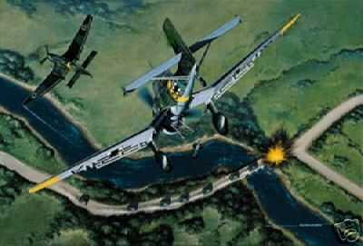
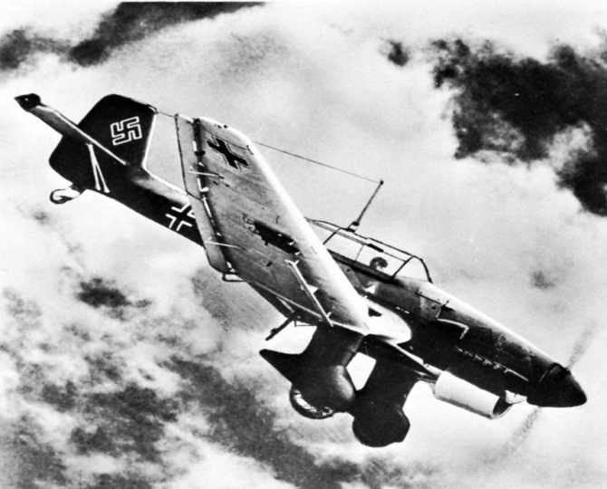
Stage one
First the Luftwaffe (German Air force), used dive bombers to attack airfields and communications targets – power lines, phone lines, bridges, roads, railway tracks.
Soften up the enemy

Slide 5
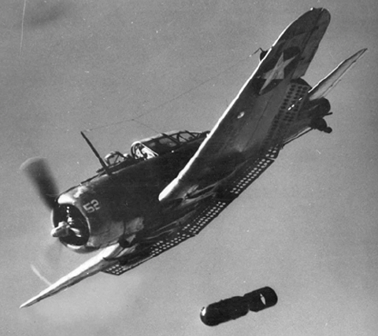
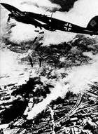
Stage One

Slide 7
Stage two
Then the army moved in using tanks, motorbikes, armoured cars
This meant that they could break through the lines quickly and attack the enemy and key targets

Slide 8
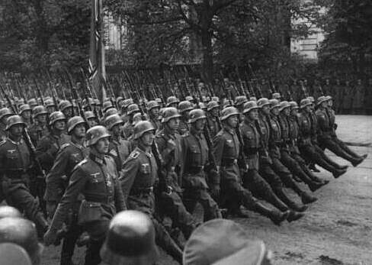
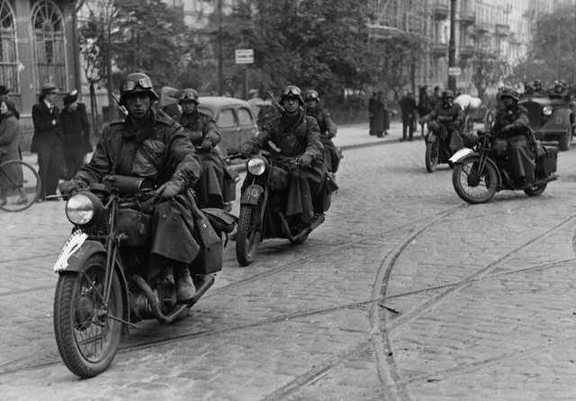
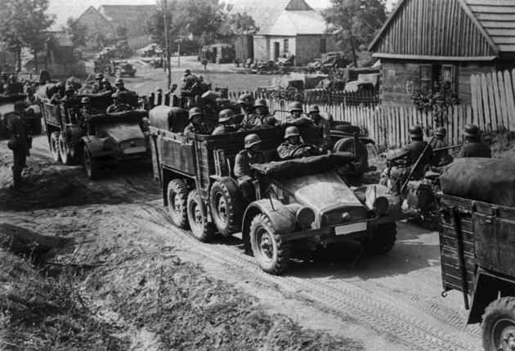
Stage two

Slide 10
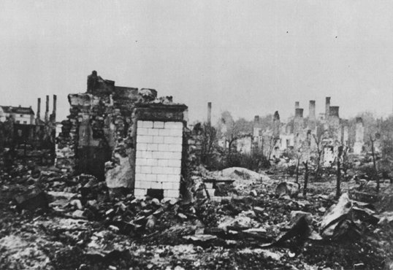
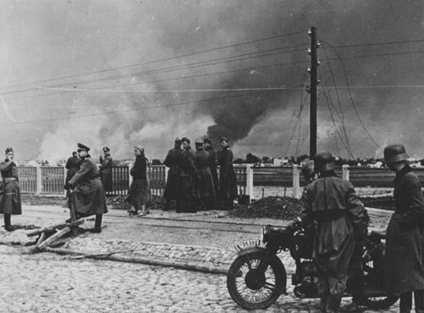
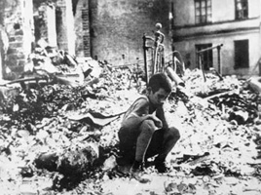
ATTACK ON POLAND 1939
Used Blitzkrieg tactics against Poland
They attacked on many fronts at the same time and quickly over ran the Polish army

Slide 12
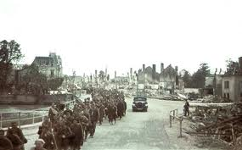
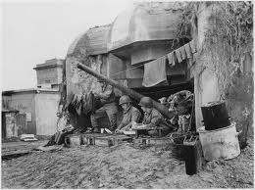
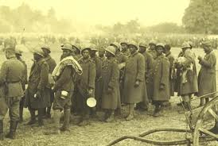
Very Effective
Took 5 weeks to capture France

Slide 13
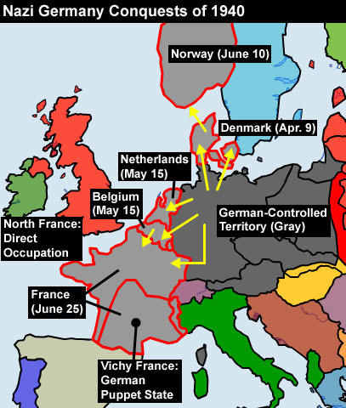

Slide 14
Blitzkrieg Simulation

Slide 15
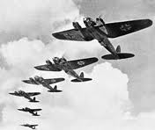
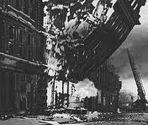
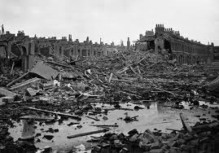
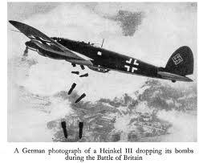
Battle of Britain
Hitler bombs London for 57 straight days
Tough times for British

Slide 16
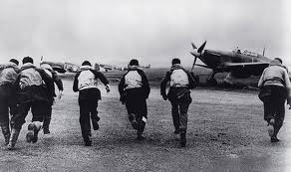
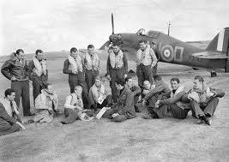
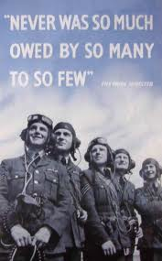
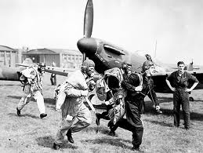
British win.
Mostly due to British fighter pilots.
Hitler’s
1st defeat!

Slide 17
Horrible Histories

Slide 18
READ IT

Slide 19
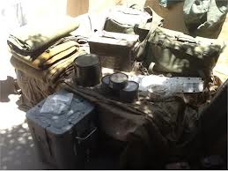
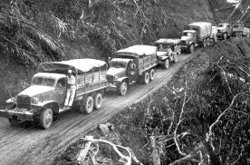
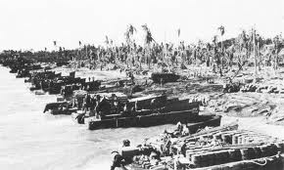
World war ii
The United States was officially neutral in war.
Gave Allies supplies
Helped US get out of the depression

Slide 20
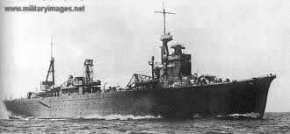
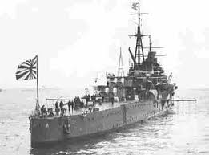
Japan
Almost complete control of the Pacific
Only obstacle was U.S. fleet at Pearl Harbor

Slide 21
US View of Japan
disliked Japans imperialistic ways
imposes embargo on Japan

Slide 22
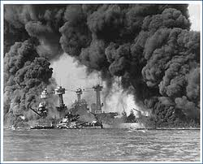
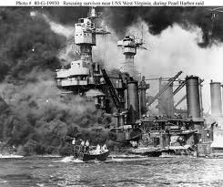
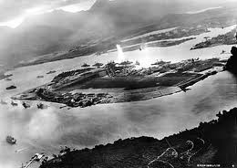
Pearl Harbor ATTACK
Dec. 7 1941
Surprise attack
423 planes 2,335 dead

Slide 23
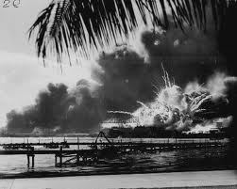

Slide 24
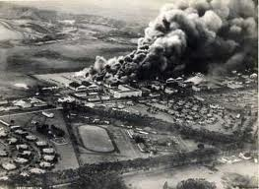

Slide 27
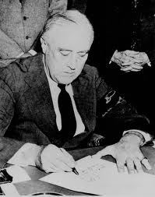
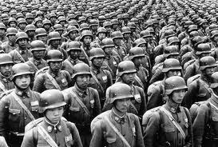
Effects of Pearl Harbor
Day after US and Britain declare war on Japan
US switches to total war in preparation

Slide 28
Pearl Harbor Video Clip
http://www.youtube.com/watch?v=1e6h9h7ky0E

Slide 29
READ IT

