Slide 1
Agenda
Review (Block 3 Cinderella Assignment)
Spanish Civil War
Notes
Video
The Nanking Massacre
Reading like a historian

Slide 2
Objectives
Explain the importance of the Spanish Civil War.
Determine what happened at the invasion of Nanking.

Slide 3
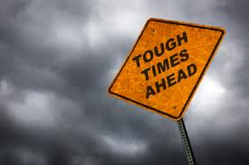
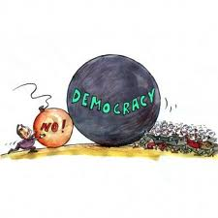
153. Spanish Civil War
Between WWI & WWII tough times for democracy.

Slide 4
Other options…
Socialism on the left
Fascism on the right

Slide 5
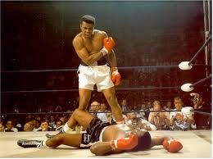
Down goes democracy
Had fallen in Italy, Germany
Eastern and central Europe as well

Slide 6
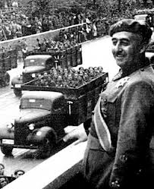
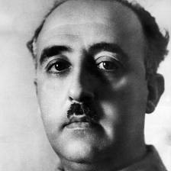
Spain
Prior to WWII, fascists led by Francisco Franco tried to overthrow republic in Spain.

Slide 7
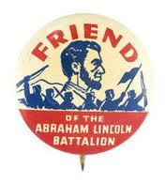
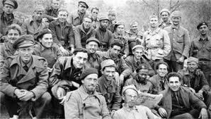
Volunteers…
From many countries went to help Spain stop Franco.

Slide 8
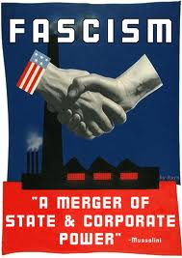
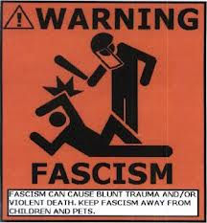
Fascist Power!
Franco supported by Mussolini and Hitler

Slide 9
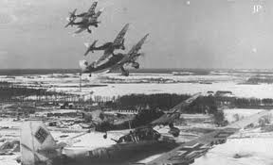
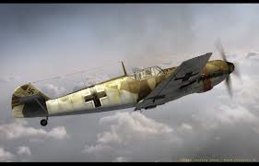
German Test
Hitler wanted to test Luftwaffe on human targets.
German air force

Slide 10
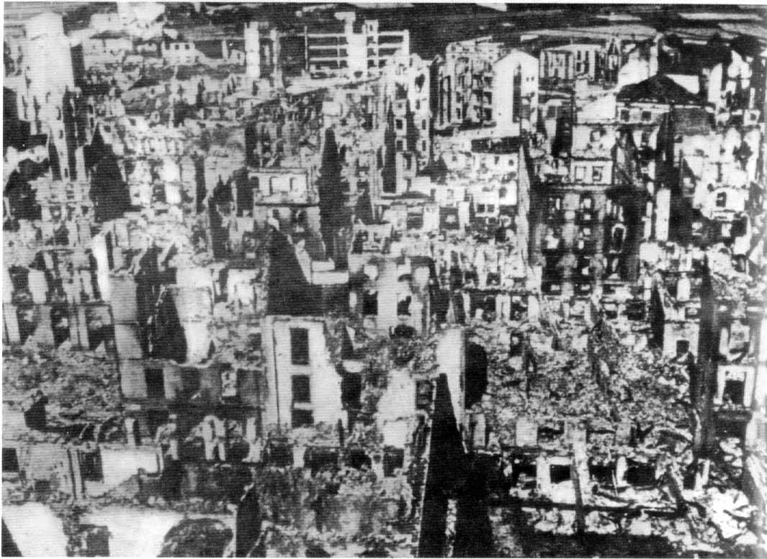
Luftwaffe
Hitler bombs Guernica
Killed 1600 civilians
Horrified the world

Slide 11
Picasso’s Guernica

Slide 12
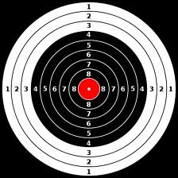
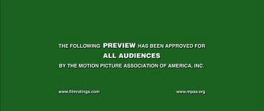
Hitler’s Terror Raid
Foreshadows things to come….
Civilians now target.

Slide 13
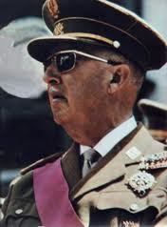
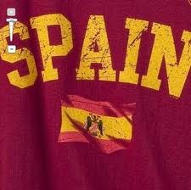
Franco’s Reign
After 3 years Franco defeats republican government
He remained in power until 1975

Slide 14
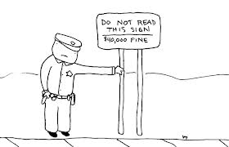
Read Spanish Civil War
Highlight

Slide 15
154. The Invasion of Nanking

Slide 16
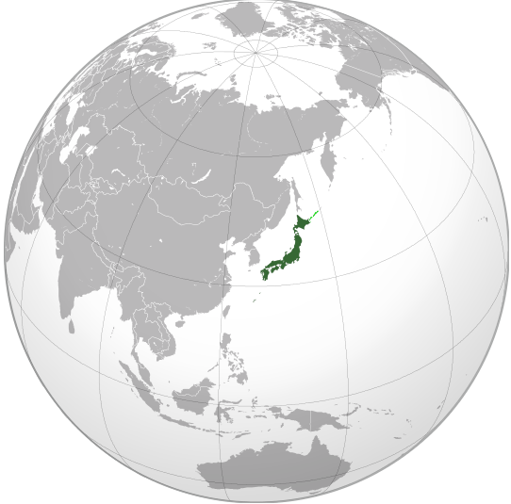
Context: Japan, 1930
Japan suffered from economic problems.
Japan was geographically small.
World View of Japan
Notes:
Image from: http://en.wikipedia.org/wiki/File:Japan_(orthographic_projection).svg

Slide 17
Goals of Japan’s military leaders
expand Japan’s empire to gain more raw materials
restore Japan’s power in Asia and the world

Slide 18
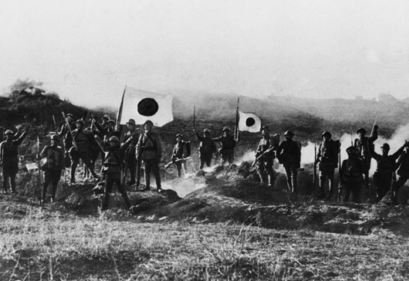
Invasion of China
Japan invaded China’s northern region of Manchuria in 1931.
This area was rich with iron and coal.
Japanese soldiers in Manchuria
Notes:
Source: http://www.tmakiguchi.org/assets/images/timeline/1928-36/big/TM027.mainichi.jpg

Slide 19
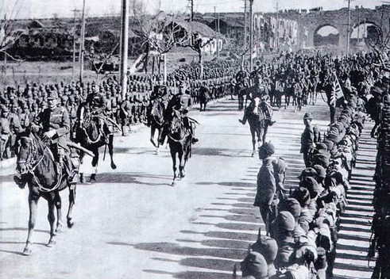
Invasion of Nanking
Nanking was China’s capital.
Japan invaded Nanking in December 1937.
Japanese Soldiers entering Nanking

Slide 20
Central Historical Question
What happened during the invasion of Nanking?

Slide 21
Discussion
After reading documents A and B, can you accurately answer what happened during the invasion of Nanking? Why or why not?

Slide 22
Which of these textbooks, if either, do you find more trustworthy? Why?

Slide 23
Where else would you look in order to figure out what happened during the Japanese invasion of Nanking?

Slide 24
Corroborate

Slide 25
Final Discussion
Why might textbooks from different countries offer different versions of the same historical events?
When confronted with conflicting historical accounts, what is the best way to determine which is more accurate or trustworthy?

Slide 26
Read it

