Slide 1
Agenda
Pass back quizzes
Review last class
Australia
Notes/video
Opium War
Notes/video
Primary Source

Slide 2
Objectives
Describe how Australia is an example of British Imperialism
Explain how the Opium War is an example of British Imperialism.

Slide 3
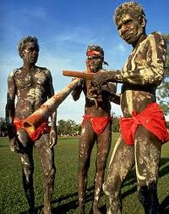
133. Australia
Settled by Aborigines 50,000 years ago

Slide 4
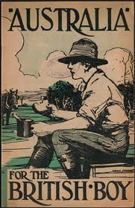
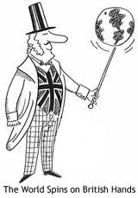
British “discovery”
Took place in 1700s
James Cook
British didn’t imperialize until mid 1800s with discovery of gold.

Slide 5
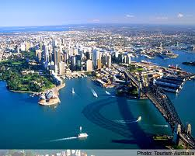
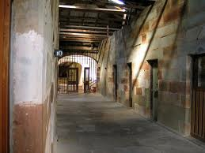
Australia
Started as a prison colony
Of the first 1000, 750 were inmates

Slide 6
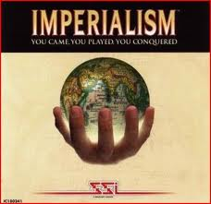
3 Cs of European Colonization
Conquest
Conquer
Cill, I mean Kill!!
This happens to the aborigines in Australia

Slide 7
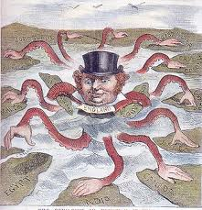
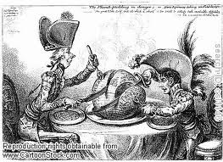
By 1868…
British stopped sending prisoners
Population of 1 million
162,000 were prisoners

Slide 8
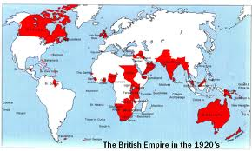
Australia
Read
Highlight

Slide 9
How is heroin impacting Baltimore City?
What do you think life is like as a heroin addict?
How does drug usage affect the United States?
Notes:
Link this to the roots of heroine-opium

Slide 10
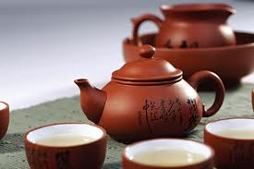
134 Opium War
In 1800, China was wealthiest country on planet.
The British LOVED Chinese tea

Slide 11
Problem?
Chinese didn’t like anything the British had.
Trade imbalance drained silver from Britain

Slide 12
What should Britain do?
nothing and continue drinking their tea
Tell them you are going to stop drinking their tea if they don’t start trading with you
Stop trading with them
Illegally get their people addicted to opium so they have to pay you in silver

Slide 13
What should Britain do?
nothing and continue drinking their tea
Tell them you are going to stop drinking their tea if they don’t start trading with you
Stop trading with them
Illegally get their people addicted to opium so they have to pay you in silver

Slide 14
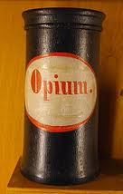
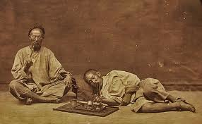
Britain: the drug dealer?
Yup!
Grows opium in INDIA sells it in China
Gets as much as a third of the population addicted to opium

Slide 15
By the numbers…

Slide 16
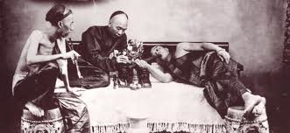
Chinese Response?
Opium was illegal in China
Qing emperor asked them to stop
British didn’t
Ordered for it to be stopped, destroyed opium

Slide 17
What should the British do?
accept the Emperors decision and move on
Try to get around the Emperor by selling it anyway
Declare war on China for destroying British opium, and then force them to pay for the costs of war

Slide 18
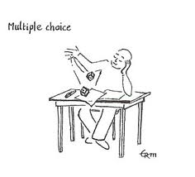
What should the British do?
accept the Emperors decision and move on
Try to get around the Emperor by selling it anyway
Declare war on China for destroying British opium, and then force them to pay for the costs of war

Slide 19
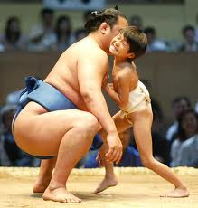
War
British declare war in 1839
Easy victory because of advanced ships/weapons

Slide 20
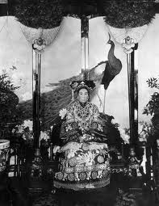
Qing Dynasty?
Forced to open ports to the west.
Continued to weaken
Ends in 1911

Slide 21
Primary Source
Partner up and read the document and answer the questions.
Notes:
This letter is from Lin Zexu, he was put in charge of stopping the Opium trade. He wrote this letter to the Queen and tried to use reason to deplore her to stop this terrible trade. This helps the students understand the Chinese point of view.

